Slide 1
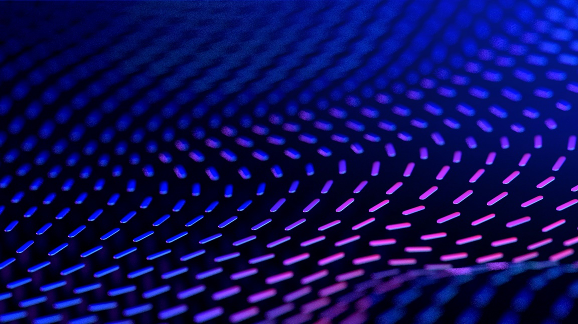

Curriculum Connect
Valentine’s Day
Lá Fhéile Vailintín
Visual Assets: https://scratch.mit.edu/
Scratch is a project of the Scratch Foundation, in collaboration with the Lifelong Kindergarten Group at the MIT Media Lab. It is available for free at https://scratch.mit.edu

Slide 2
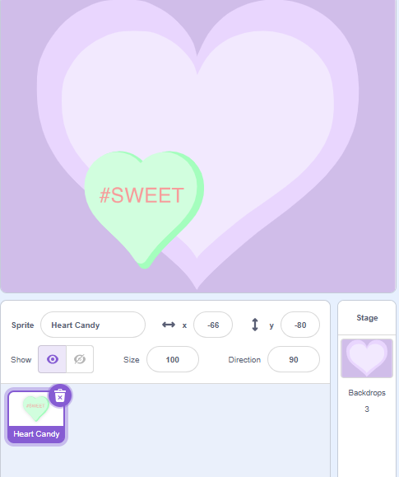
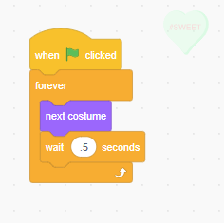
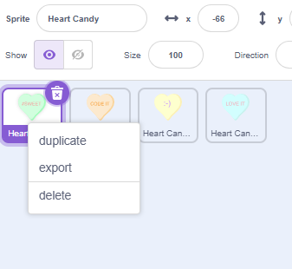
Happy Valentine’s Day – level 1 Curriculum Connect: Valentine’s Day. STEM - Technology - coding
Stage and Sprites
Code – Heart Candy
Heart Candy - copy
After writing Heart Candy code
Right click on Heart Sprite
Select duplicate a number of times to create lots of hearts.
Press the Green Flag to run.
Forever block
Select next costume block.
Pause between costumes.
Select a Stage
Add “Heart Candy” Sprite
Scratch is a project of the Scratch Foundation, in collaboration with the Lifelong Kindergarten Group at the MIT Media Lab. It is available for free at https://scratch.mit.edu

Slide 3
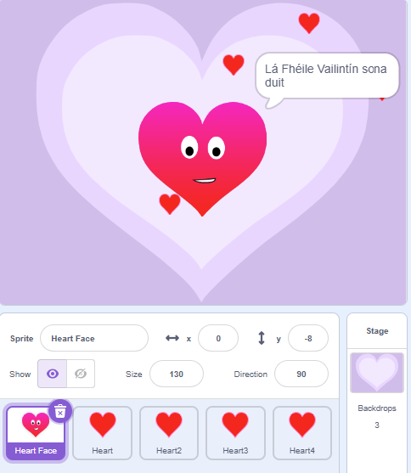
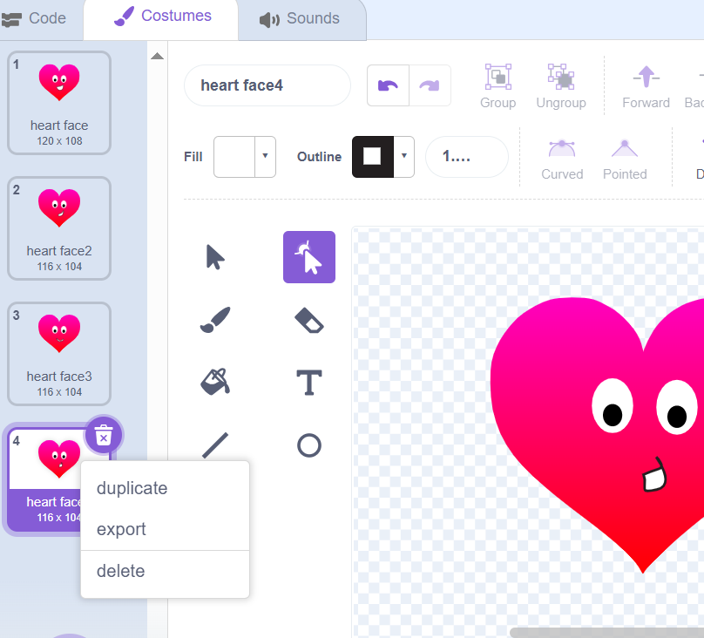
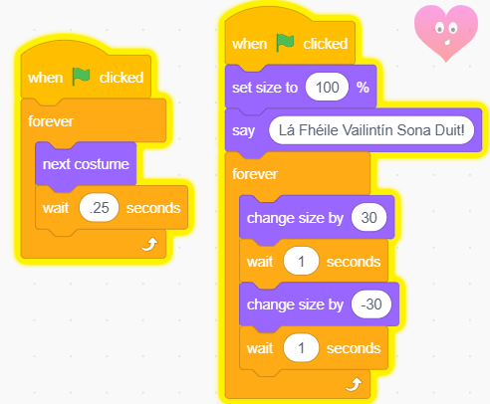




Lá Fhéile Vailintín – Animation level 2 – part 1 Curriculum Connect: Valentine’s Day. Gaeilge. STEM - Math: degrees, percentage. Technology - coding
Stage and Sprites
Edit Heart Face
Code – Heart Face
In Costumes section:
Select heart face;
Right click and duplicate.
Edit the mouth shape using arrow
Heart Face Sprite – Part 1
Add costumes and edit mouth
Heart Sprite – Part 2
add code for sprite then duplicate sprite
Change costumes so the heart’s mouth is moving.
Say “Lá Fhéile Vailintín sona duit”
Change size to appear as a beating heart.
Scratch is a project of the Scratch Foundation, in collaboration with the Lifelong Kindergarten Group at the MIT Media Lab. It is available for free at https://scratch.mit.edu

Slide 4
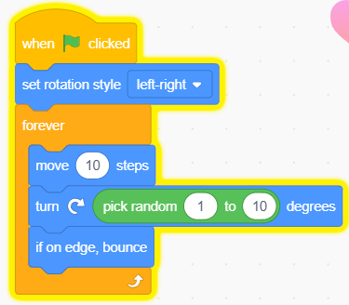
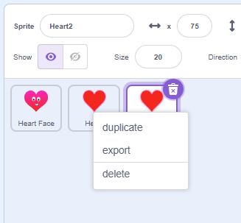
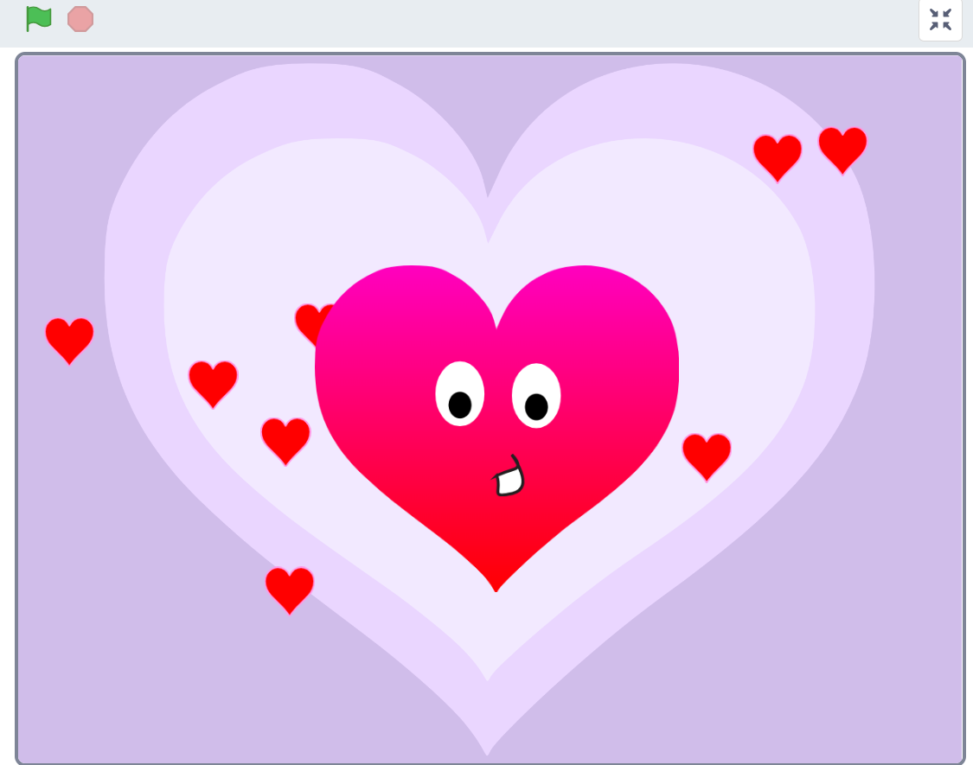
Lá Fhéile Vailintín Animation – level 2 – part 2
Code – Heart
Code – Heart
Lá Fhéile Vailintín
After writing Heart code
Right click on Heart Sprite
Select duplicate a number of times to create lots of hearts. The code will copy too
Press the Green Flag to run.
Now use your imagination and have fun making changes to the code!
Set rotation so heart doesn’t flip.
Forever, move 10 steps and turn in random rotations.
If it is on the edge of the screen bounce back in.
Scratch is a project of the Scratch Foundation, in collaboration with the Lifelong Kindergarten Group at the MIT Media Lab. It is available for free at https://scratch.mit.edu

Slide 5
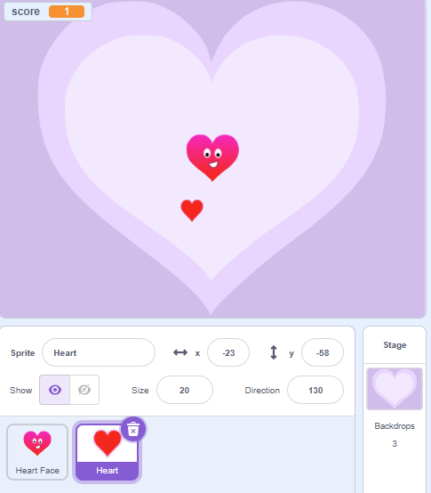
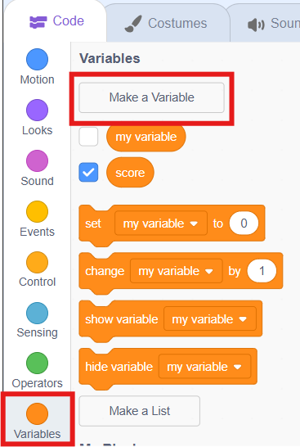
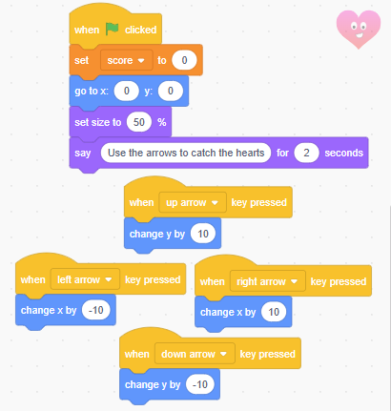
Valentine’s Game – level 3 – For laptops Curriculum Connect: Valentine’s Day. STEM - Math: degrees, percentage, x and y coordinates. Technology – coding Game: The Heart Face must catch the small hearts to earn a score.
Stage and Sprites
Code – Heart Face
Code – Heart Face
Select a Stage backdrop
Add a Heart Face Sprite
Add a Heart Sprite
Set Score to 0
Use “up down left right” key press events.
Move by changing x and y values.
Create a variable and call it score.
Scratch is a project of the Scratch Foundation, in collaboration with the Lifelong Kindergarten Group at the MIT Media Lab. It is available for free at https://scratch.mit.edu

Slide 6
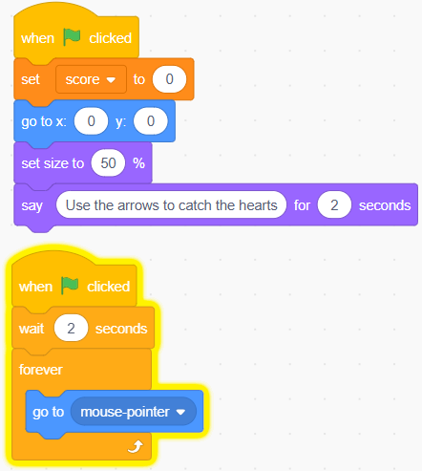
Valentine’s Game – level 3 – For Tablets Game: The Heart Face must catch the small hearts to earn a score.
Code – Heart Face
Stage and Sprites
Code – Heart Face
Set Score to 0
Place heart in centre of screen
Use your finger to move the heart face.
Use your mouse if you are on a laptop.
Select a Stage backdrop
Add a Heart Face Sprite
Add a Heart Sprite
Create a variable and call it score.
Scratch is a project of the Scratch Foundation, in collaboration with the Lifelong Kindergarten Group at the MIT Media Lab. It is available for free at https://scratch.mit.edu

Slide 7
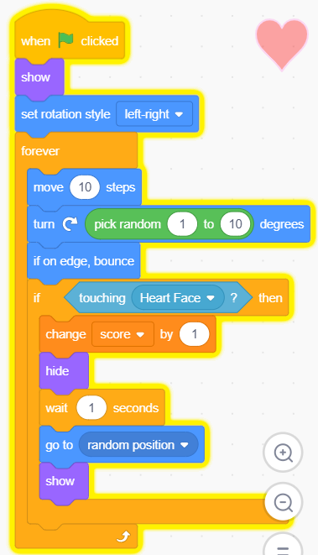
Valentine’s Game – level 3 – part 2
Code – Heart
Code – Heart
Code – Heart
Show – make heart visible
Set rotation so heart doesn’t flip.
Forever,
move 10 steps and turn in random rotations.
If it is on the edge of the screen bounce back in.
If the Heart Face touches the Heart
Increase score by 1
hide
wait 1 minute
then show again in a random place.
After writing Heart code
Right click on Heart Sprite
Select duplicate a number of times to create lots of hearts.
Press the Green Flag to run.
Scratch is a project of the Scratch Foundation, in collaboration with the Lifelong Kindergarten Group at the MIT Media Lab. It is available for free at https://scratch.mit.edu

