Slide 1



Curriculum Connect
St. Patrick’s Day
Lá Fhéile Pádraig
Visual Assets: https://scratch.mit.edu/
Scratch is a project of the Scratch Foundation, in collaboration with the Lifelong Kindergarten Group at the MIT Media Lab. It is available for free at https://scratch.mit.edu

Slide 2

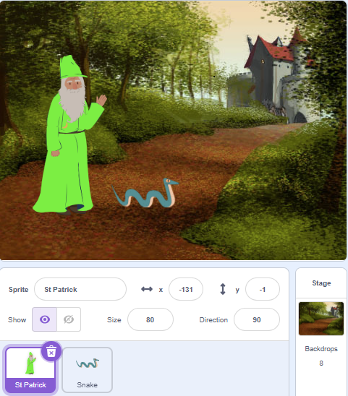
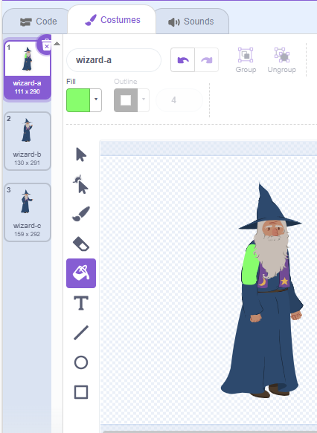
Happy St. Patrick’s Day – level 1 Curriculum Connect: St. Patrick’s Day. STEM - Technology – coding. English sentence structure and conversation
Stage and Sprites
Edit Wizard
For each Costume
Select Fill Bucket and set the Fill Colour.
Click the wizard to change the colour.
Select a Stage
Add “Wizard” and “Snake” Sprites
Scratch is a project of the Scratch Foundation, in collaboration with the Lifelong Kindergarten Group at the MIT Media Lab. It is available for free at https://scratch.mit.edu

Slide 3
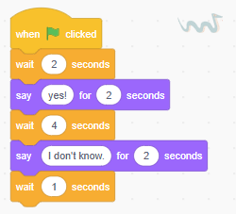
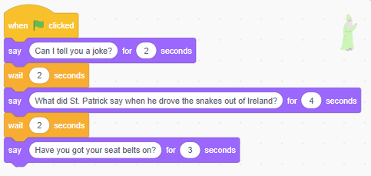
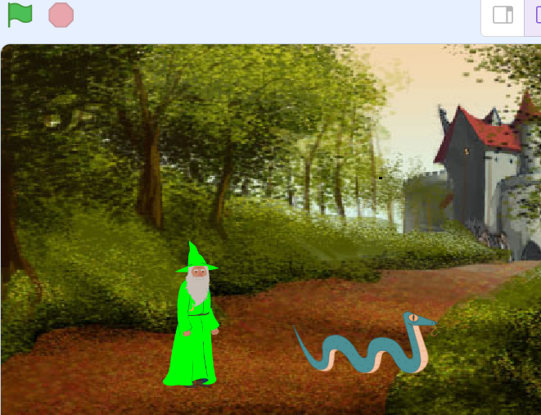
Happy St. Patrick’s Day – level 1 Curriculum Connect: St. Patrick’s Day. STEM - Technology – coding. English sentence structure and conversation
Code – Wizard
Code – Snake
Use “Say” blocks and “Wait” blocks to allow the character to talk to each other
Press the Green Flag to see St. Patrick and the snake having a laugh!
Scratch is a project of the Scratch Foundation, in collaboration with the Lifelong Kindergarten Group at the MIT Media Lab. It is available for free at https://scratch.mit.edu

Slide 4
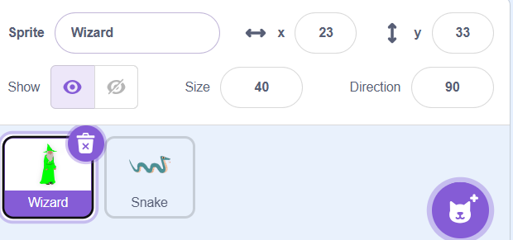
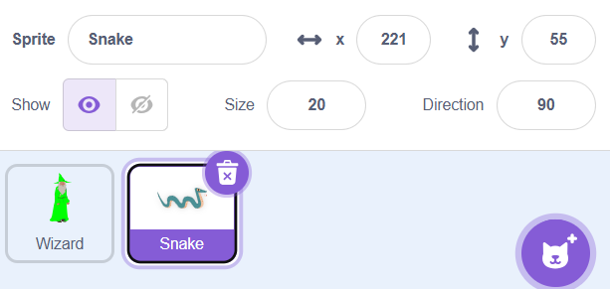


Happy St. Patrick’s Day – level 2 Curriculum Connect: St. Patrick’s Day. STEM - Technology – coding. English sentence structure and conversation
Stage and Sprite
Stage and Sprite
Stage and Sprite
For each Costume
Select Fill Bucket and set the Fill Colour.
Click the wizard to change the colour.
Set The Size of the Wizard to 40
Set The Size of the Snake to 20.
Select the Wizard and Snake Sprite
Select the Castle Backdrop.
Scratch is a project of the Scratch Foundation, in collaboration with the Lifelong Kindergarten Group at the MIT Media Lab. It is available for free at https://scratch.mit.edu

Slide 5
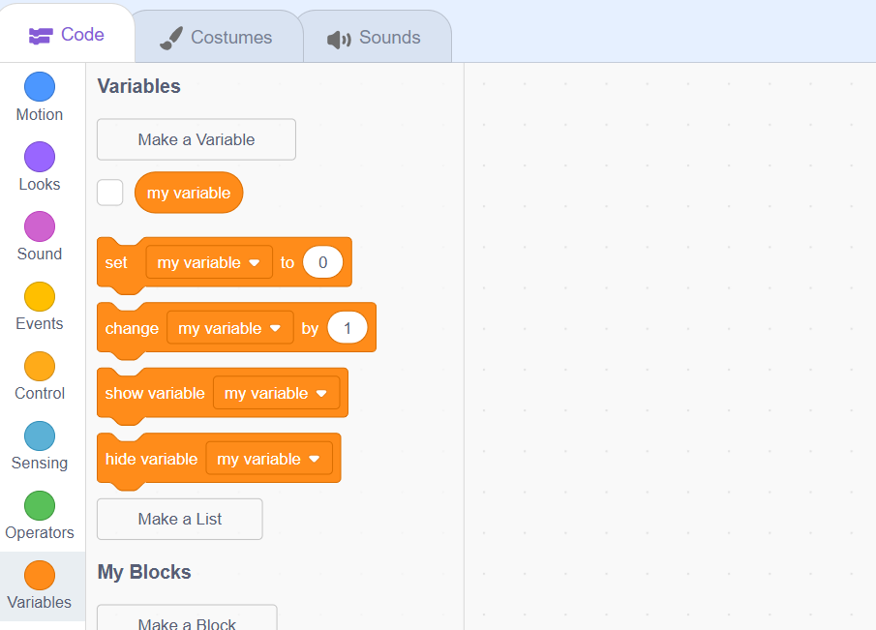
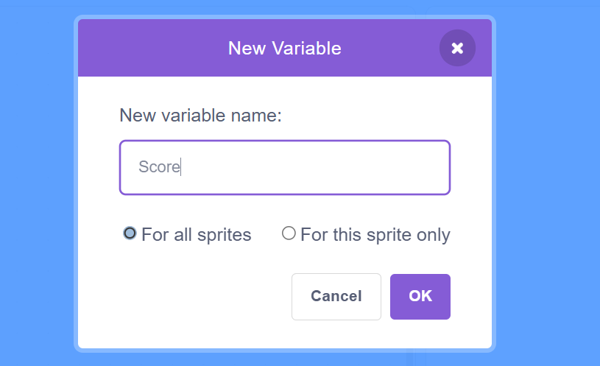
Happy St. Patrick’s Day – level 2
Stage and Sprite
Create a Variable
Before we begin, Select Variable in the code menu and we will create a Variable.
Once you have this selected, select “Make a Variable” and name this “Score”
Set The Size of the Wizard to 40
Set The Size of the Snake to 20.
Scratch is a project of the Scratch Foundation, in collaboration with the Lifelong Kindergarten Group at the MIT Media Lab. It is available for free at https://scratch.mit.edu

Slide 6
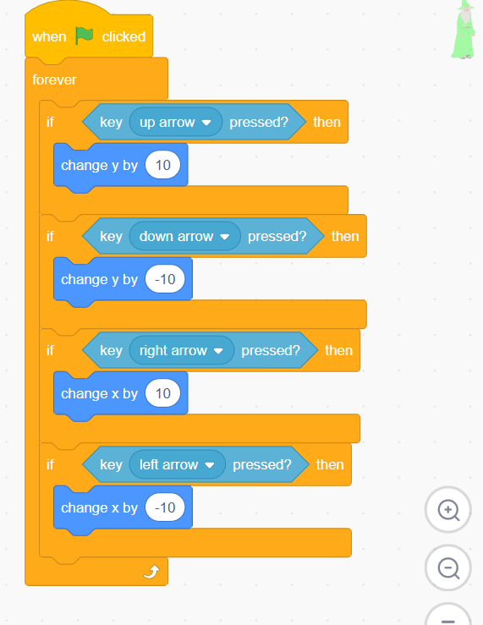
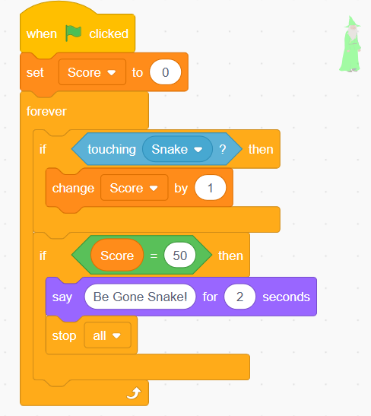
Happy St. Patrick’s Day – level 2
Code – Wizard
Code – Wizard
Events Flag Clicked
Control Forever
Control If, Then
Sensing up arrow
Motion Y (Up)
Control If,Then
Sensing down arrow
Motion Y (Down)
Control If ,Then
Sensing Right arrow
Motion X (Right)
Control If, Then
Sensing Left X
Motion X (Left)
This code Creates our scoreboard and tells the wizard that when it touches the snake it gets a point!
Events Flag Clicked
Variable set Score to 0
Control Forever
Control If, Then
Sensing touching Snake?
Variable Change Score by 1
Control If, Then
Operators 0=0
Variables Score
Looks Say Be Gone Snake! For 2 seconds
Control Stop all
This Chain of Code controls the movement of St.Patrick or the “Wizard”.
Scratch is a project of the Scratch Foundation, in collaboration with the Lifelong Kindergarten Group at the MIT Media Lab. It is available for free at https://scratch.mit.edu

Slide 7
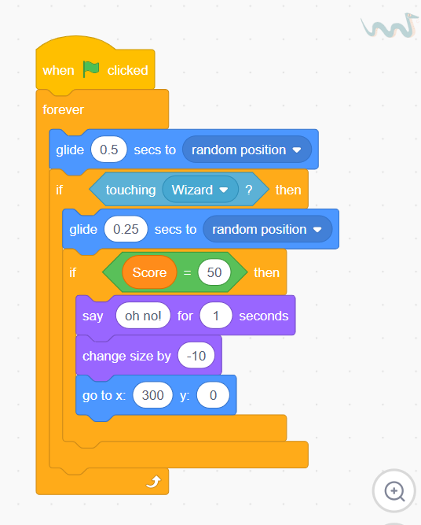
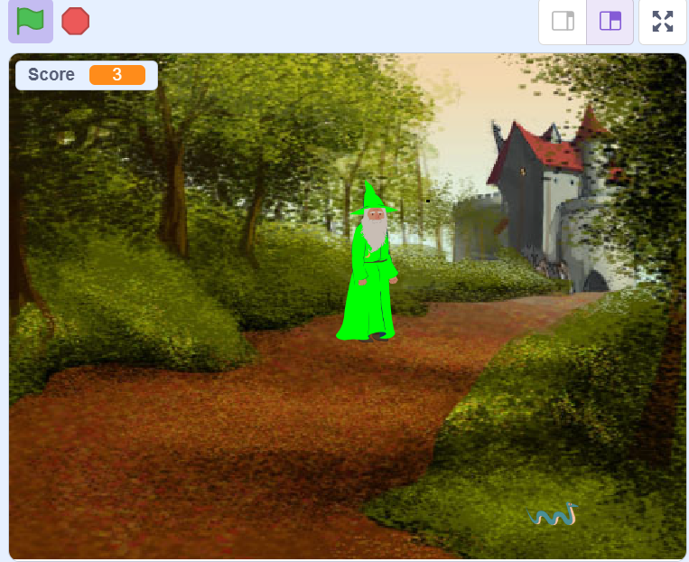
Happy St. Patrick’s Day – level 2
Code – Snake
Enjoy!
Events Flag Clicked
Control Forever
Motion glide 0.5 secs to random position
Control If, Then
Sensing touching Wizard
Motion glide 0.25 secs to random position
Control If ,Then
Operators 0=0
Looks say oh no! for 1 seconds
Looks change size by -10
Motion go to x 300 y 0
Press the green flag in the top left to chase the Snake! Once you have touched the snake 50 times the snake leaves and says Oh no! Saint Patrick lets out a triumphant cry, “Be Gone!” and the Snake disappears.
This Chain of code tells the snake to move to random positions to avoid Saint Patrick. It also tells it once the score reaches 50 to whimper “oh no!” and disappears from the screen.
Scratch is a project of the Scratch Foundation, in collaboration with the Lifelong Kindergarten Group at the MIT Media Lab. It is available for free at https://scratch.mit.edu

Slide 8
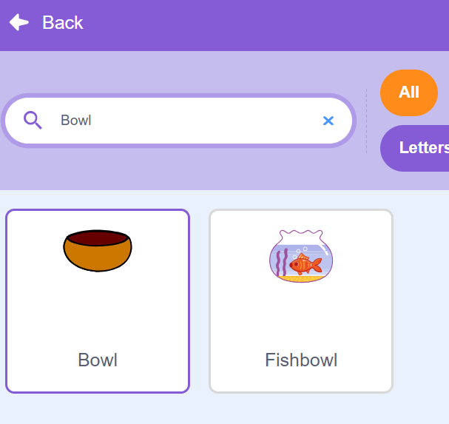
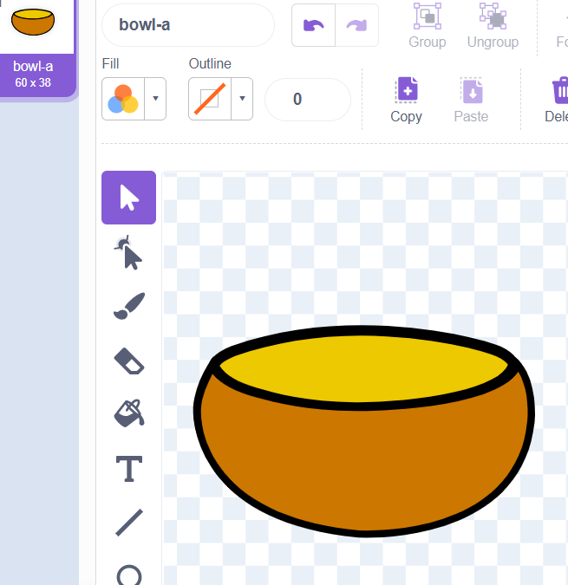
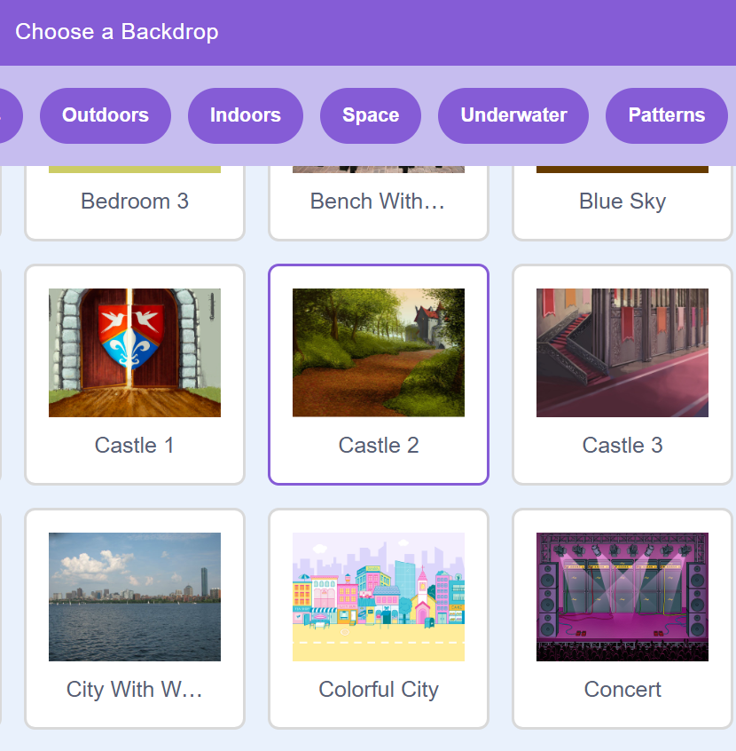

Happy St. Patrick’s Day – level 3
Introduction
Stage and Sprites
Edit The Bowl
We’re going to create a fun and fast-paced game to celebrate St Patrick’s Day! You’ll design your own pot of gold and add shiny coins to bring your game to life.
Stage and Sprites
Search & Select the "Bowl" sprite.
In the top left, select costumes to edit our sprite into a pot of gold.
1.Select the bucket icon and fill the top of the bowl gold
Scratch is a project of the Scratch Foundation, in collaboration with the Lifelong Kindergarten Group at the MIT Media Lab. It is available for free at https://scratch.mit.edu

Slide 9
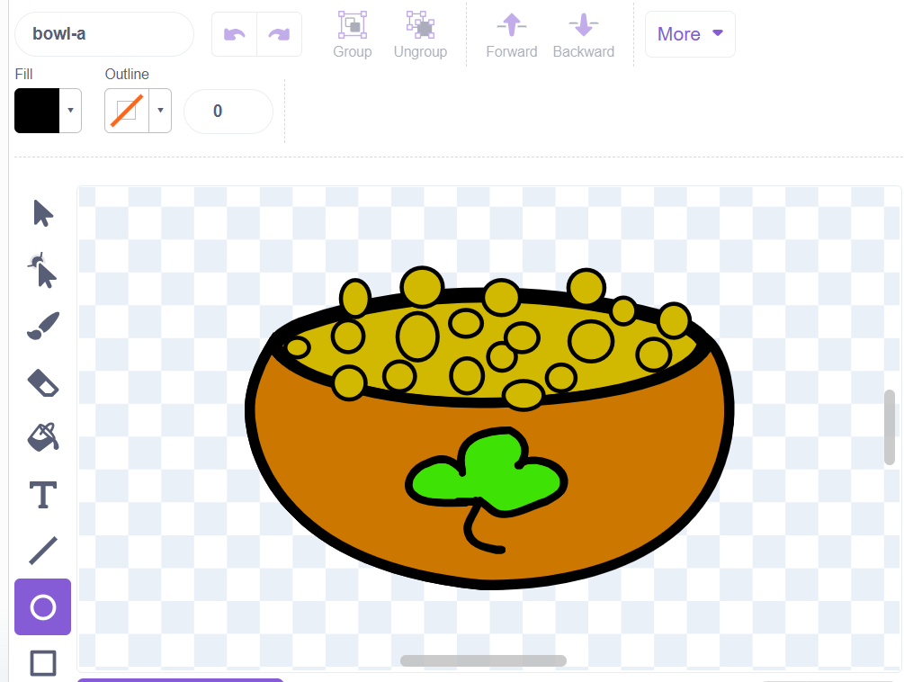
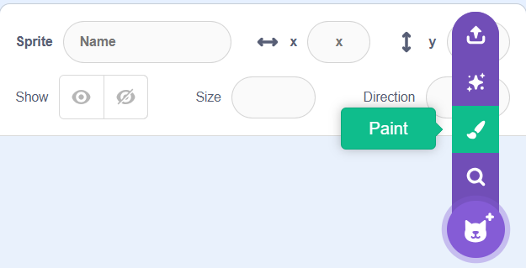
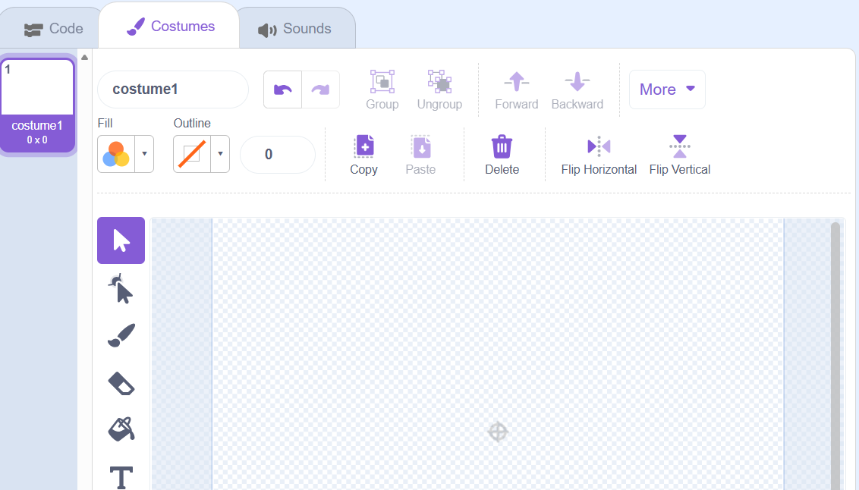
Happy St. Patrick’s Day – level 3
Edit The Bowl
Create your own Sprite!
Hover over the Cat icon in the bottom right of your screen. On the pop up menu select the paintbrush “Paint”.
1 .Select the circle icon and draw “coins”
2 . Use the bucket to fill the coins we drew as gold
3 . Use the paintbrush to draw a shamrock!
TIP: Use the “Fill” section to change the colour!
This Screen will pop-up!
Scratch is a project of the Scratch Foundation, in collaboration with the Lifelong Kindergarten Group at the MIT Media Lab. It is available for free at https://scratch.mit.edu

Slide 10
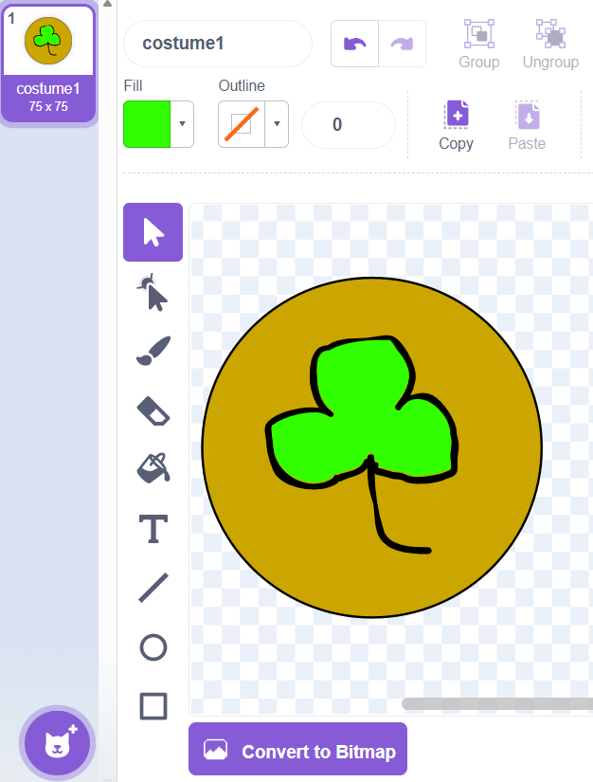
Happy St. Patrick’s Day – level 3
TIP: Use the “Fill” section to change the color!
Create your own Sprite!
Create a Variable
Before we begin, Select Variable in the code menu and we will create a Variable.
3.Draw a Shamrock with the paintbrush Icon and fill the centre green.
Once you have this selected, select “Make a Variable” and name this “Score”
2.Fill the Coin gold with the bucket icon
1.Draw a circle “Coin” with the circle Icon
Scratch is a project of the Scratch Foundation, in collaboration with the Lifelong Kindergarten Group at the MIT Media Lab. It is available for free at https://scratch.mit.edu

Slide 11
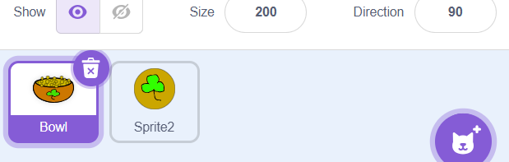
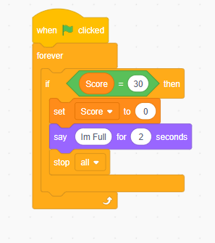

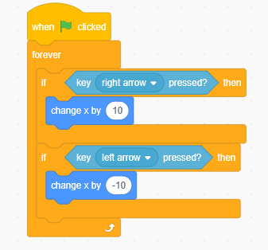
Happy St. Patrick’s Day – level 3
Bowl-Code
Bowl-Code
Select the Bowl Sprite
Bowl-Code- Movement
Events-When Green Flag Clicked
Control-Forever
Control-If, then
Sensing-Key right arrow pressed?
Motion-Change x by
Control-If, then
Sensing-Key left arrow pressed?
Motion-change x by
Events-When Green Flag Clicked
Control-Forever
Control-If, then
Operators-0=0
Variables- “Score”
Variables-set “Score” to 0
Looks -say “Im Full!” for 2 seconds
Events- stop all
Tip: You can put smaller blocks inside bigger blocks — like boxes inside boxes. 📦 Example: If,then else (Big Block)> 0=0 (Medium Block) > Score (Small Block)
Scratch is a project of the Scratch Foundation, in collaboration with the Lifelong Kindergarten Group at the MIT Media Lab. It is available for free at https://scratch.mit.edu

Slide 12
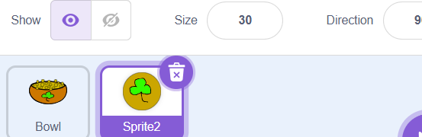
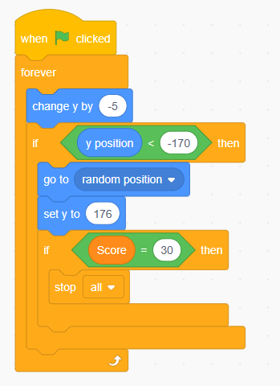

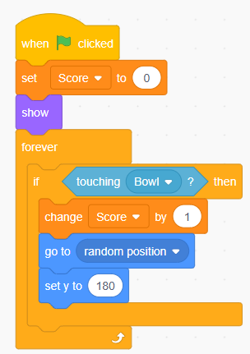
Happy St. Patrick’s Day – level 3
Coin-Code
Coin-Code
Select the Coin “Sprite 2” Sprite
Events-When Green Flag Clicked
Control-Forever
Motion-Change y by
Control-If, then
Operators-0<0
Motion-y position
Motion-go to random position
Motion-set y to 180
Control-If, then
Operators-0=0
Variables- “Score”
Events- stop all
Events-When Green Flag Clicked
Variables-set
“Score” to 0
Looks -say “Im Full!” for 2 seconds
Control-Forever
Control-If, then
Sensing-Touching Bowl?
Variables-Change
“Score” by 1
Motion-go to
random position
Motion-set y to
180
This chain of code tells the coin To spawn randomly at the top of the screen. It also tells it to drop from the top of the screen. Finally, it is told to up the score when it lands in the pot and to end the game once the score reaches 30!
Scratch is a project of the Scratch Foundation, in collaboration with the Lifelong Kindergarten Group at the MIT Media Lab. It is available for free at https://scratch.mit.edu

Slide 13
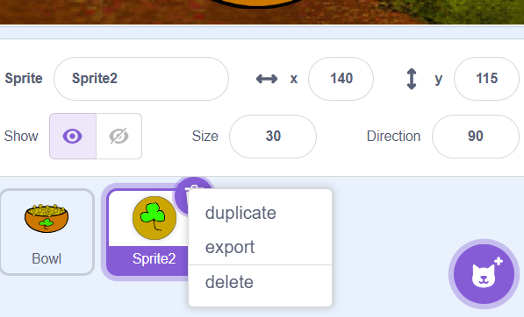
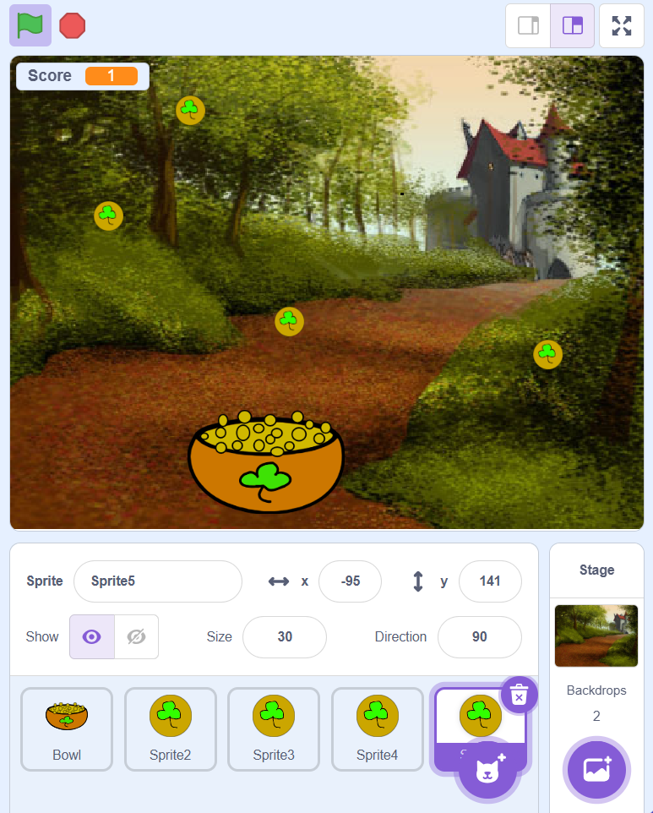

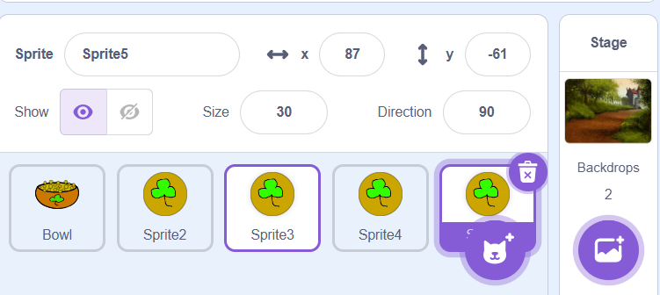


Happy St. Patrick’s Day – level 3
Coin-Code
Enjoy!
Press the Green Flag in the top left to begin the game!
Right-click on your second sprite and duplicate the 4-5 times.
Tip
Use the left arrow and right arrow located in the bottom right of your keyboard to move the Pot of Gold across your screen! Collect 30 Coins to win!
Your Screen should look something like this!
Scratch is a project of the Scratch Foundation, in collaboration with the Lifelong Kindergarten Group at the MIT Media Lab. It is available for free at https://scratch.mit.edu

