Slide 1



Curriculum Connect
Easter
An Cháisc
Visual Assets: https://scratch.mit.edu/
Scratch is a project of the Scratch Foundation, in collaboration with the Lifelong Kindergarten Group at the MIT Media Lab. It is available for free at https://scratch.mit.edu

Slide 2
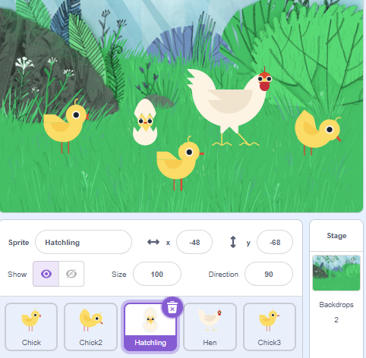
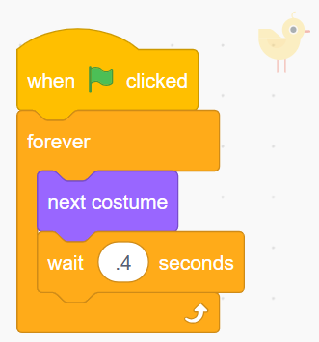
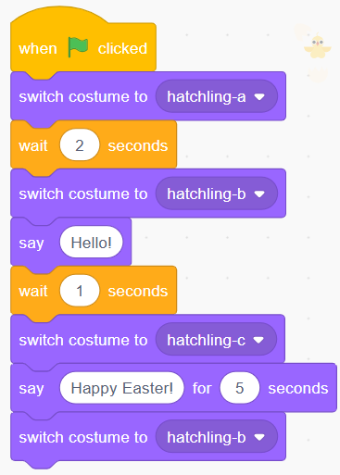
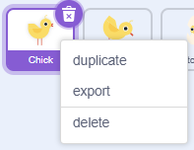
Easter – Level 1
Curriculum Connect: Easter. STEM - Technology – coding. Mathematics
Happy Easter Animated Message!
  Stage and Sprites
  Code – Hen and Chicks
  Code - Hatchling
Select the Forest Stage
Add “Chick”, “Hen” and “Hatchling” Sprites
Switch costumes and use wait blocks to animate the Sprites
Code a Chick, right click and Duplicate
Duplicate Chicks
Scratch is a project of the Scratch Foundation, in collaboration with the Lifelong Kindergarten Group at the MIT Media Lab. It is available for free at https://scratch.mit.edu

Slide 3



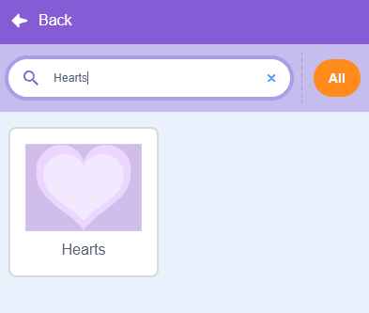
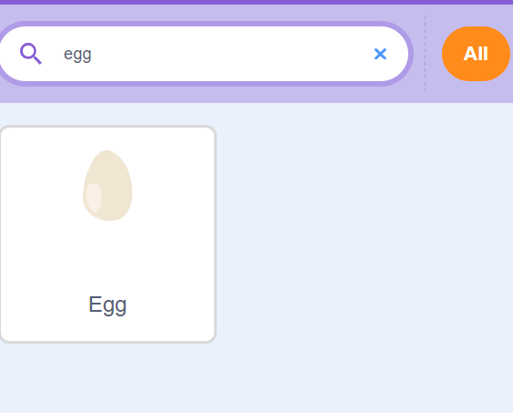
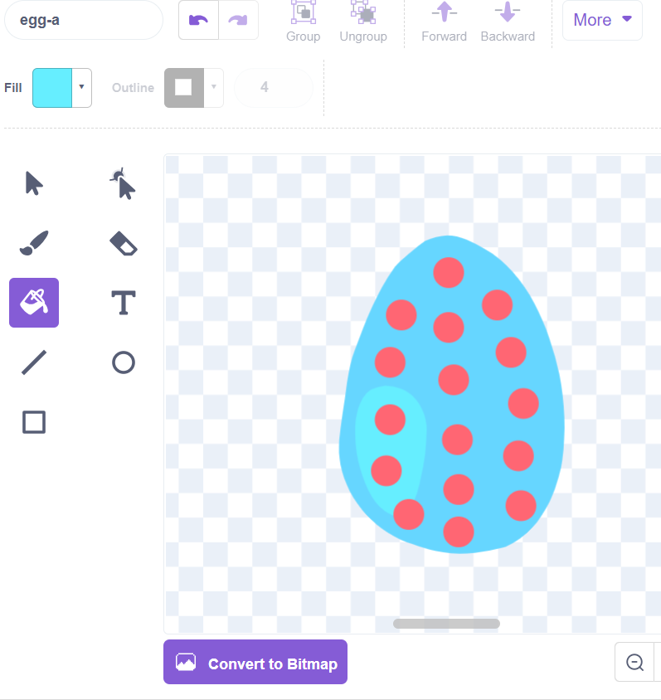
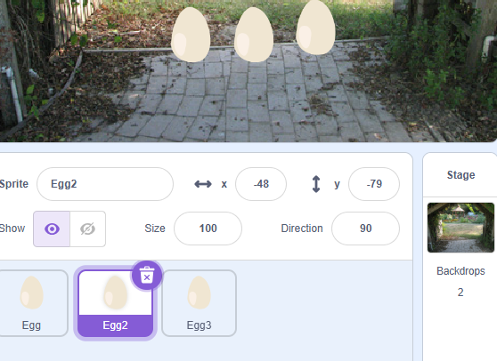
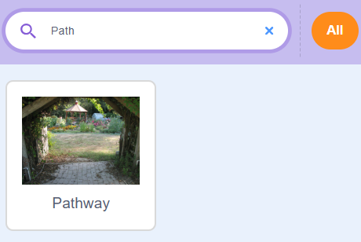
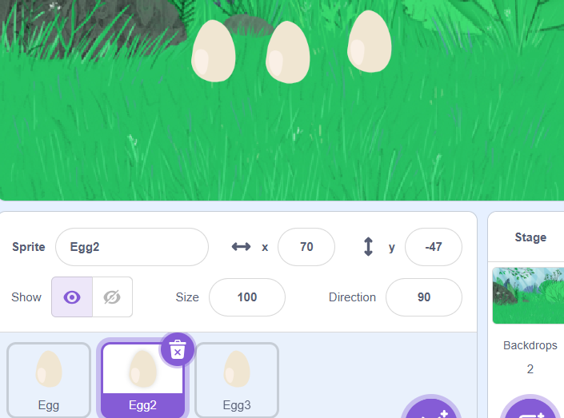
Easter hunt– Level 2 – Part 1
Curriculum Connect: Easter. STEM - Technology – coding. Mathematics
Find and Select the eggs on the screen to win the game!
  Egg Customization
  Stage and Sprites
  Add and Customize Balloons Sprites
Select your sprite and press the "Costumes" button
1. Press the bucket and then "Fill" to choose your color. Click the Egg to change the Color!
2. Select the Brush and decorate your egg!
Add the "Hearts" and “Pathway” Backdrop
Select the “Egg" sprite 3 times
Do this for all 3 eggs, picking a different color for each!
Scratch is a project of the Scratch Foundation, in collaboration with the Lifelong Kindergarten Group at the MIT Media Lab. It is available for free at https://scratch.mit.edu

Slide 4

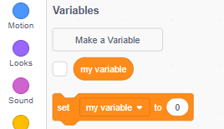
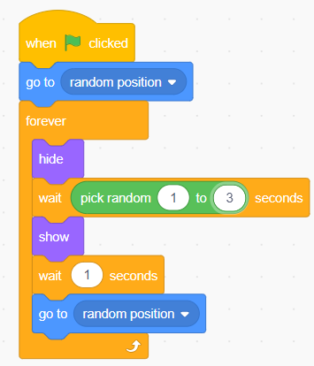
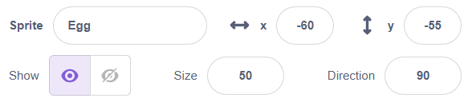
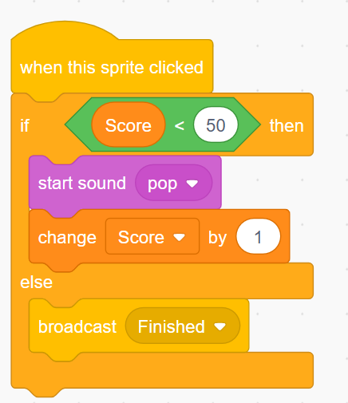
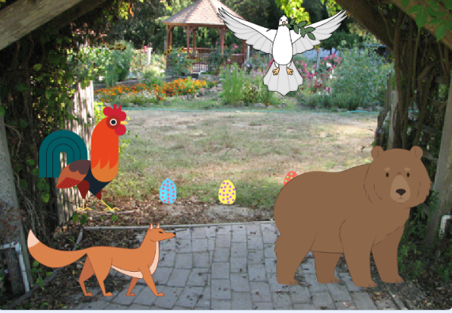
Easter egg hunt– Level 2 – Part 2
Curriculum Connect: Easter. STEM - Technology - coding Mathematics
Click "Variables"> Make A Variable> Name this "Score"
  More Customization!
  Egg Code
Click Your First Egg and make the code below!
Change each Egg Size to 50!
Drag "If then else" from Control.
Beside If take "0 < 50" from Operators, then drag " Score" from Variables into the first box
Press the upside-down arrow in the "change my variable by 1" and "broadcast message1" to change it to "Score" and "Finished"
Add the “Bear“, “Fox“, “Rooster" and “Dove” Sprites and move them into these positions
Drag out wait 1 seconds from "Control" section, then drag and place Pick random 1 to 10 seconds from "Operators" section into the 1 box.
Scratch is a project of the Scratch Foundation, in collaboration with the Lifelong Kindergarten Group at the MIT Media Lab. It is available for free at https://scratch.mit.edu

Slide 5


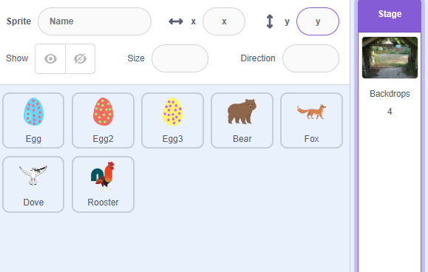
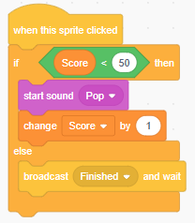
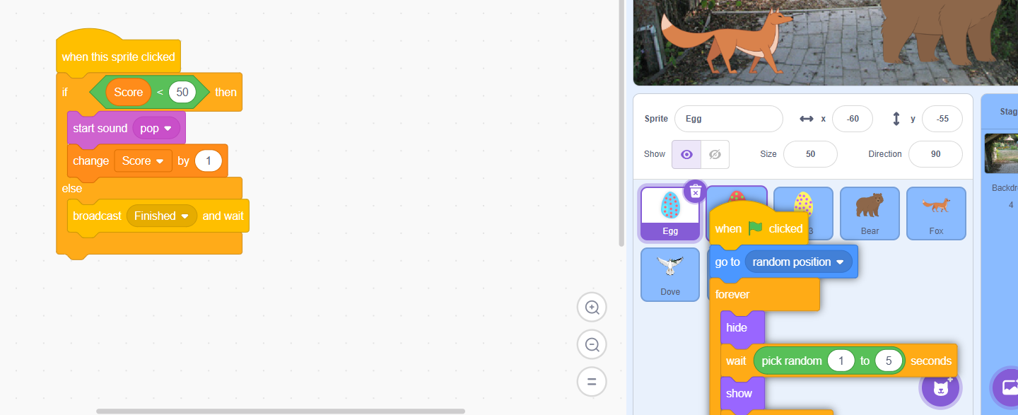



Easter egg hunt – Level 2 – Part 3
Curriculum Connect: Easter. STEM - Technology - coding Mathematics
  Lets Start Our Stage Code!
  Copy your code to ALL Eggs!
Select your "Stage"
Select "Sounds"
Click, hold and drop your code from HERE to each Egg, The Eggs will shake before you move the code. This is called a drag and drop!
Each Egg will now have the code you built!
Press this Button in the Bottom Left and Choose the sound "Cheer" then return to Code
Scratch is a project of the Scratch Foundation, in collaboration with the Lifelong Kindergarten Group at the MIT Media Lab. It is available for free at https://scratch.mit.edu

Slide 6

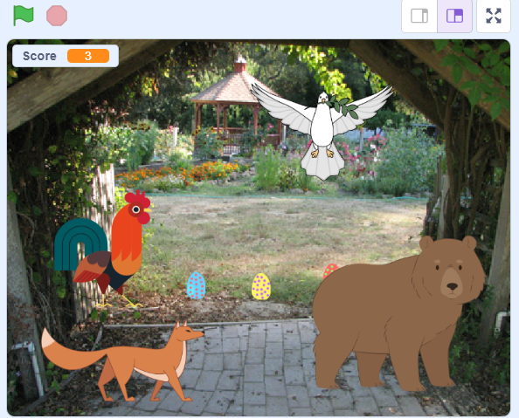
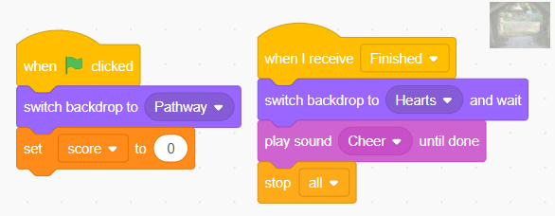
Easter egg hunt – Level 2 – Part 4
Curriculum Connect: Easter. STEM - Technology - coding Mathematics
  Enjoy!
  Stage- Code
Select "Set Variable to 0" from Variables then click the triangle beside "Variable" to change it to "Score"
Select "Play sound Pop until done" from Sounds then click the triangle beside "Pop" to change it to "Cheer"
Select "Switch backdrop to Pathway and wait" from Looks then click the triangle beside "Forest" to change it to "Hearts".
Press the Green Flag above your mini screen to start the game.
Try click as many eggs as possible before the screen changes.
The eggs will move randomly every 1-5 seconds.
Scratch is a project of the Scratch Foundation, in collaboration with the Lifelong Kindergarten Group at the MIT Media Lab. It is available for free at https://scratch.mit.edu

Slide 7
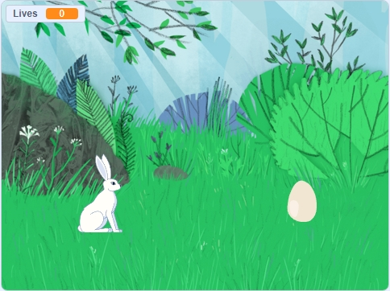
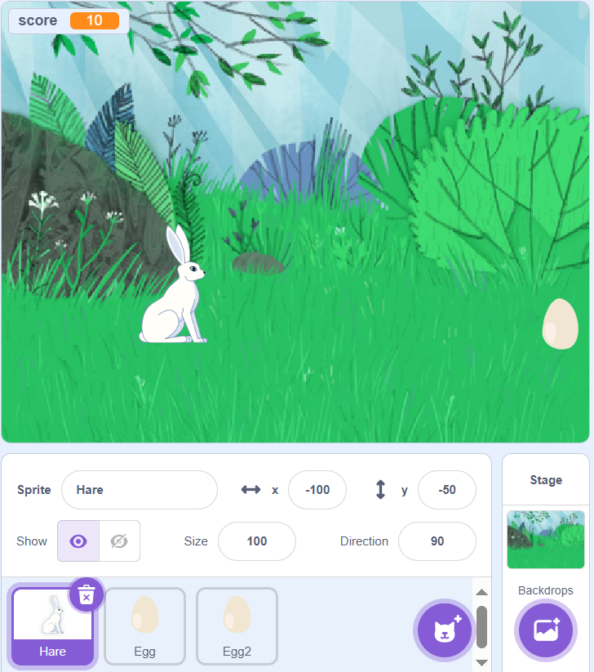
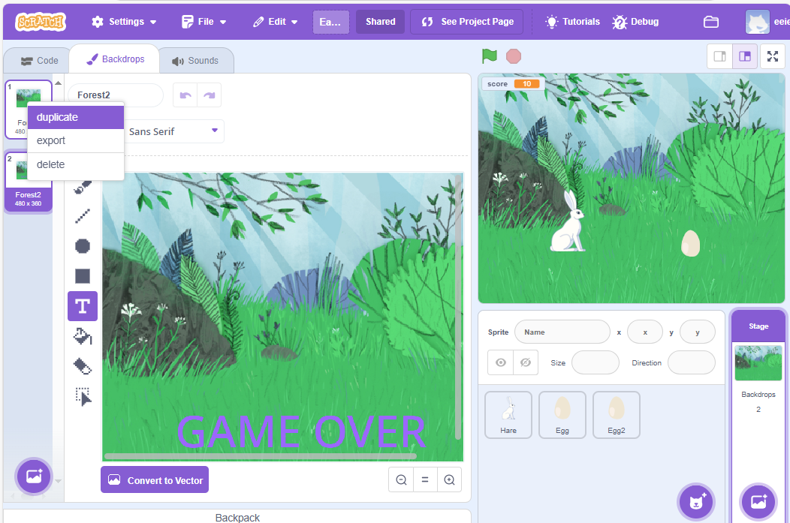
Easter – Level 3 – Part 1 Game Rabbit Jump
Curriculum Connect: Easter. STEM - Technology – coding. Mathematics
Click on the rabbit to jump over the eggs! You get 10 chances!
  Stage and Sprites
  Add a Second Backdrop to the Stage
2. Select Backdrops
3. Duplicate
Backdrop
1. Select Stage
4. In New Backdrop, Add “Game Over” Text
Add a “Hare” and an “Egg” Sprites
Create a variable and call it score.
Scratch is a project of the Scratch Foundation, in collaboration with the Lifelong Kindergarten Group at the MIT Media Lab. It is available for free at https://scratch.mit.edu

Slide 8
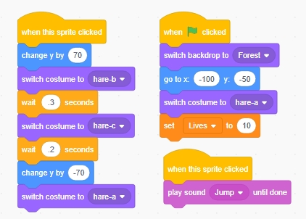
Easter – Level 3 – Part 2 Rabbit Jump
Curriculum Connect: Easter. STEM - Technology - coding
  Hare - Code
Create a new Variable called Lives
When Green flag clicked.
Set Backdrop
Position the Hare
Change Costume
Set Lives to 10
Add a “When this sprite clicked”
Change Y by 70 to make the sprite jump up
Switch Costumes and wait to animate the Hare
Change Y by -70 to jump back down
Add a “When this sprite clicked”
Play Jump Sound
Scratch is a project of the Scratch Foundation, in collaboration with the Lifelong Kindergarten Group at the MIT Media Lab. It is available for free at https://scratch.mit.edu

Slide 9
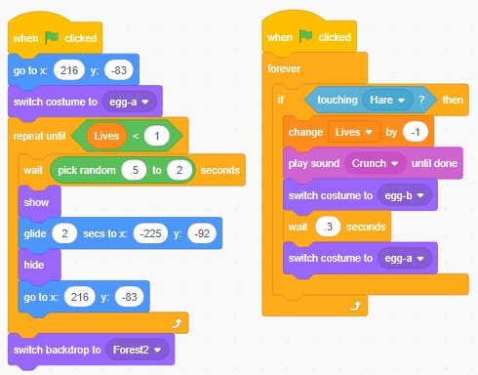
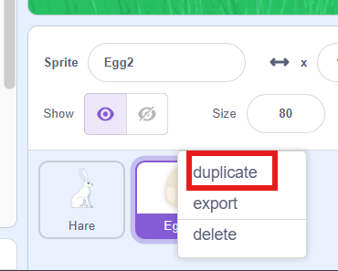
Easter – Level 3 – Part 3 Rabbit Jump
  Egg - Code
This code moves the Egg from the right of the stage to the left and “repeats until” the lives variable is less than 1.
Game Over when 10 Eggs are broken
If the Hare touches the Egg
Change the lives variable by -1
Switch the Egg costume.
Create another Egg!!
Select duplicate
Scratch is a project of the Scratch Foundation, in collaboration with the Lifelong Kindergarten Group at the MIT Media Lab. It is available for free at https://scratch.mit.edu

