Slide 1
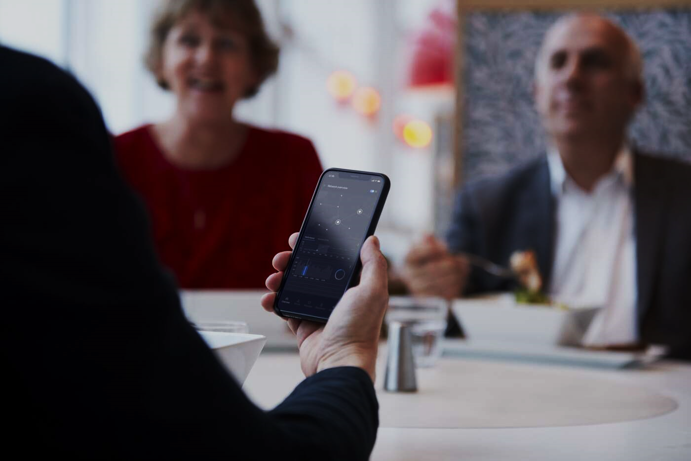
Afflicted seniors
– and the tech solutions to improve their quality of life
Ericsson Consumer and Industry Lab
2020-12-07

Slide 2
Interest for seniors: Second billion of seniors is arriving
1 in 5
is the share of global population to be expected being 60+ y.o. in 2040 (Today it’s 1 in 8)
Countries with highest share of population aged 60+ in 2019
About 20 countries
of the world already have an ageing population with more than 25% of the citizens being aged 60+.
Source: UN Demographics 2019

Slide 3
Opinions of 200 million seniors globally
Methodology
Target group – Digital seniors
Internet users aged 65-74 years old across 8 countries
Expert interviews 2019
Individuals from companies
and institutions
Qualitative research 2019
Explorative with two focus groups in Stockholm incl video interviews
Quantitative research 2019
Online interviews with digital seniors. Sampling 4 000
individuals in total
Database 2001-2020
Additional survey data from Consumer Lab Analytical platform
Sweden
Canada
UK
US
Germany
Italy
China
Japan

Slide 4
Unpacking the Affliction flower
1
Less mobile
8 in 10 predict spend more time at home in future
Due to crisis ---------------------------
9 in 10 - daily life impacted by crisis
1 in 3 are afraid of depression in family due to isolation
Half fear of not get so mobile getting older
Due to crisis --------------------------
Less usage of all current transport modes – inclusive walking
6
More time at home
2
Lack of fun
Affliction's flower
9 in 10 agree that retirement
for them is spending most of
their time on hobbies and other fun things
Due to crisis --------------------------
For example, 63% say crisis has had large impact on limiting their restaurant visits
6 in 10 seniors worry about the world their grand children will grow up in
Due to crisis ---------------------------
Worry more than average for:
…getting sick in Corona
…increased violence and crime
…get hacked, online fraud, fake news
5
Worries
3
Hard to get groceries
4
More lonely
Half think buying groceries is such heavy work and boring, so they won't do that when they get older
Due to crisis --------------------------
Half say crisis has had high impact on getting groceries
3 in 10 spend most of the time alone
Due to crisis -----------------------------
7 in 10 think they are highly socially impacted by crisis
Source: Ericsson ConsumerLab Analytical platform, Senior study, October 2019
Base: Online population aged 65-74 years within Canada, China, Germany, Italy, Japan, Sweden. UK and US
Base: Smartphone users aged 65–74 within Brazil, China, France, Germany, India, Italy, South Korea, Spain, Sweden, UK and US
Source: Ericsson Consumer & IndustryLab, Keeping consumer connected in a COVID-19 context (Mid-April 2020)

Slide 5
ICT – a helping tool for seniors during crisis
Share who think devices and Internet have helped them a lot in at least one way in their daily life during this Coronavirus crisis
9 in 10
among seniors claim that their devices and internet have helped them during coronavirus crisis in their daily life. Just somewhat lower than average
3 in 4
of seniors have been helped with having contact with
family and friend, but also getting groceries, going shopping, exercise and some also say accessing health care
Base: Smartphone users aged 65–74 years within Brazil, China, France, Germany, India, Italy, South Korea, Spain, Sweden, UK and US
Source: Ericsson Consumer & IndustryLab, Keeping consumer connected in a COVID-19 context (Mid-April 2020)

Slide 6
Seniors more active on their smartphones nowadays
Since 2016 seniors aged 65-74 years have increased their usage of all six internet activities 2020 on their smartphone.
In 2020 a majority now browse internet, does instant messaging, use social network, and watch short video clips daily.
Also, 2-5 in 10 seniors say they have increased their activities on their smartphone due to the crisis
Frequency of usage of the following internet activities on their smartphone between 2016 and during Corona crisis 2020
An increase of usage of each of the six different internet activities across 8 countries between 2016 and 2020
Source: Ericsson Consumer Lab Analytical platform. A comparison between 2016 and 2020 during Corona crisis
Base: Population smartphone users using respectively internet service aged 65-74 years. within 8 countries (Brazil, China, India, Italy, Spain, Germany, UK, and US.)

Slide 7
Seniors were closing the generation gap – but it changes due to crisis
Index
Self-reported time spent on-line among Seniors (60-69 y.o) in comparison with total population
(100= average among total population)
ICT Gap is closing
In a comparison between 2010 and 2020 the time spent online has increased for both seniors and others. But seniors have increased
it more, so the time spent online between the groups has now diminished to be around 20%-units' differences.
Though during the current pandemic, the relative difference is increasing (again) since mid-aged and younger have added more online time than the seniors.
Source: Ericsson ConsumerLab Analytical platform 2010-2020
Base: Population 15-69 y.o. within 17 countries (Argentina, Australia, Brazil, Canada, Check republic, China, India, Indonesia, Italy, Japan, France, Russia, South Korea, Spain, Sweden, UK, and US.)

Slide 8
Seniors are also heterogenous
 | Old traditionalists | Striving pensioners | Sociable grandparents | Mature life connoisseurs | Ageing Techies
Socio- demography | Less often children | Less often children | Married and relatively often living in apartments | Married, often well educated with higher income, living in own house | Men, well educated
Life situation | They more often feel alone, and they see relatives less often | They live and feel alone, but also health and finances limits their life. | Socialize with friends more often than other seniors. Don't think they will get lonelier when older | Life is a pleasure and concerned about climate. Higher spending, socialize with friends, exercise more | Makes money of hobby. Buy items, socialize with friends, visit restaurants, exercise, tech excitement
ICT experience | Fewer devices than average senior. Don’t do any activities off or on-line more than average | Fewer devices than average senior. Watches TV on TV screen more than average | Having home device monitoring electricity/ water more often than average senior | Drive's car, and use devices like smartphone, laptop, tablet, internet TV and have home alarm more than average seniors | More devices; smartphone, tablet, internet TV, device monitoring electricity/water, automated heating/ ventilation system and smart speaker
 | 20% | 26% | 25% | 13% | 16%
Source: Ericsson ConsumerLab Analytical platform, Senior study, October 2019
Base: Online population aged 65-74 years within Canada, China, Germany, Italy, Japan, Sweden. UK and US

Slide 9
Current tech polarization to follow also in future?
7 in 10 among tech savvy seniors browse on the Internet daily and 5 in 10 watch video clips, compared to 3 in 10 respectively 1 in 10 among traditional seniors.
3 in 10 among tech savvy seniors are very fascinated about the possibilities new mobile technology (5G) will bring, compared to only 1 in 10 among the traditional
Source: Ericsson ConsumerLab Analytical platform, Senior study, October 2019
Base: Online population aged 65-74 years within Canada, China, Germany, Italy, Japan, Sweden. UK and US

Slide 10
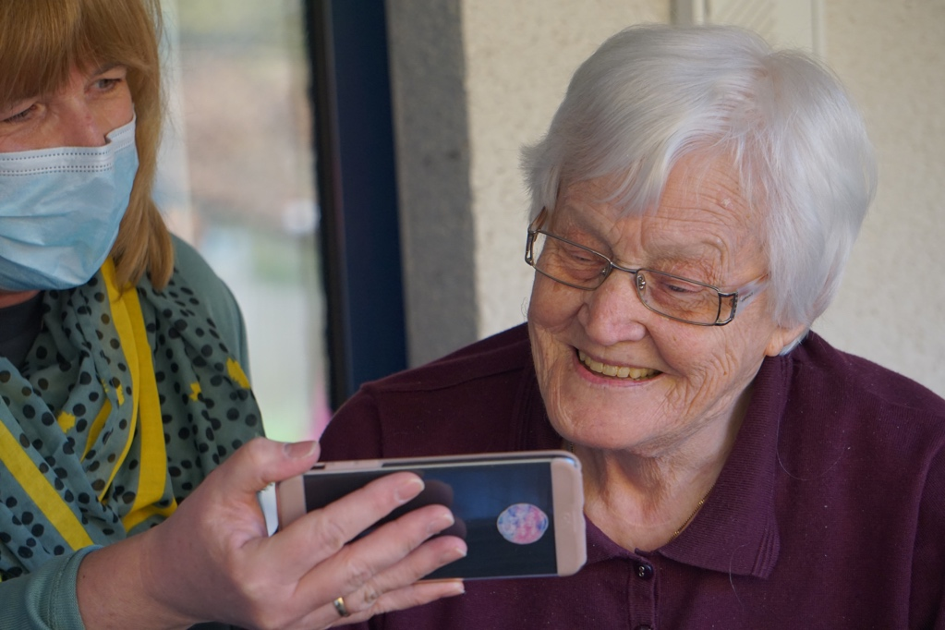
Five important areas identified to improve senior life
Home – safety, home tasks
and consumption
Wellbeing – Health
and exercise
Social life – Keeping contact
and socialize
Mobility – personal
and goods transport
Infotainment – to
get informed and entertained

Slide 11
Triple uptake of tech solutions possible
Three possible forecasts:
Expected replacement growth: Usage growth based on existing usage
Interest growth: Possible quick uptake for most new technologies 15-20 percent based on seniors 'interest in the services.
Possible additional growth: Possible additional usage growth if seniors 'preferences and needs are met
~50%
possible uptake of new tech solutions among digital seniors
Source: Ericsson Consumer Lab Analytical platform 2017-2019 and, Senior study, October 2019
Base: Online Population 65-74 years within Canada, China, Italy, Japan, Germany, Sweden, UK, and US
*General uptake calculated on interest among those today ready for new ICT
** Possible uptake calculated on expressed interest among all seniors (accounted that main barriers will be removed).

Slide 12
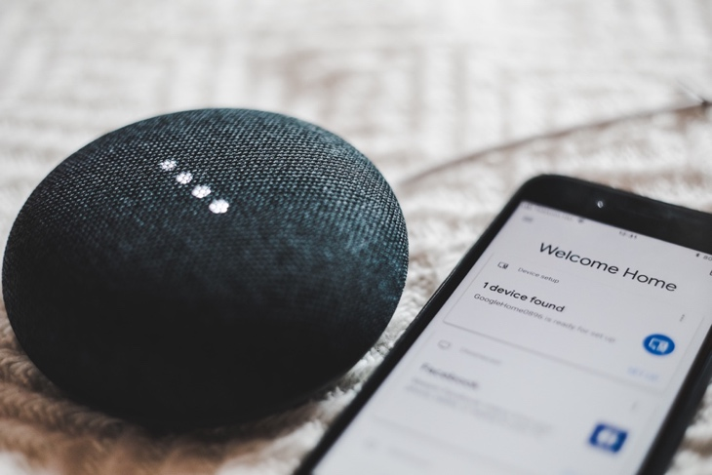
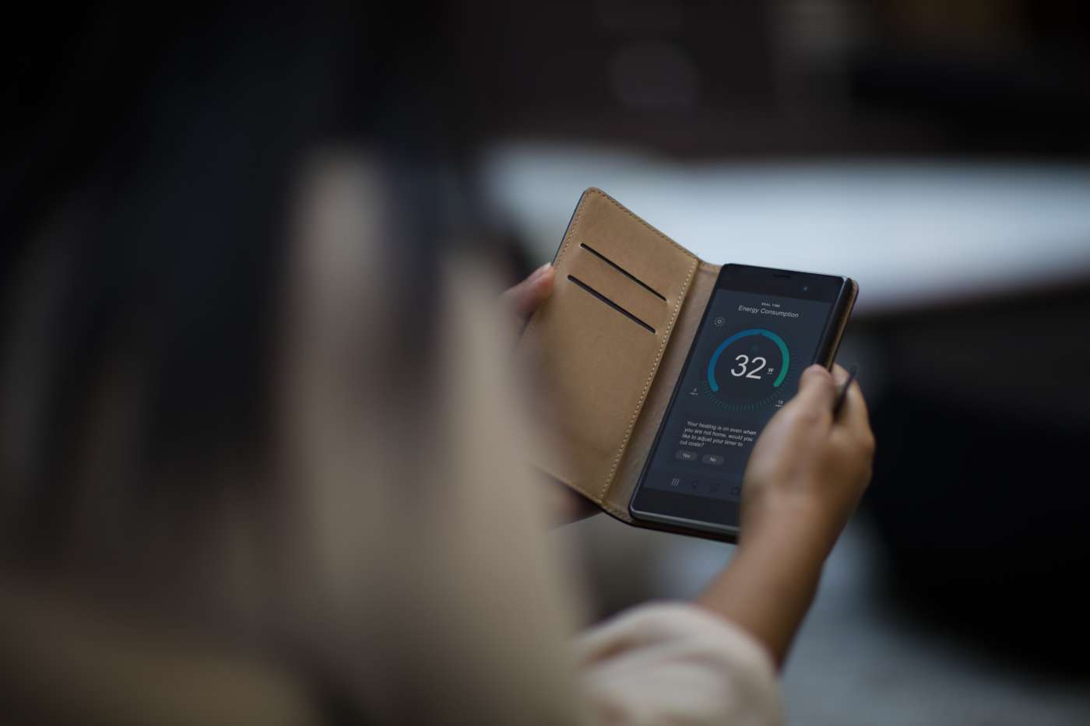
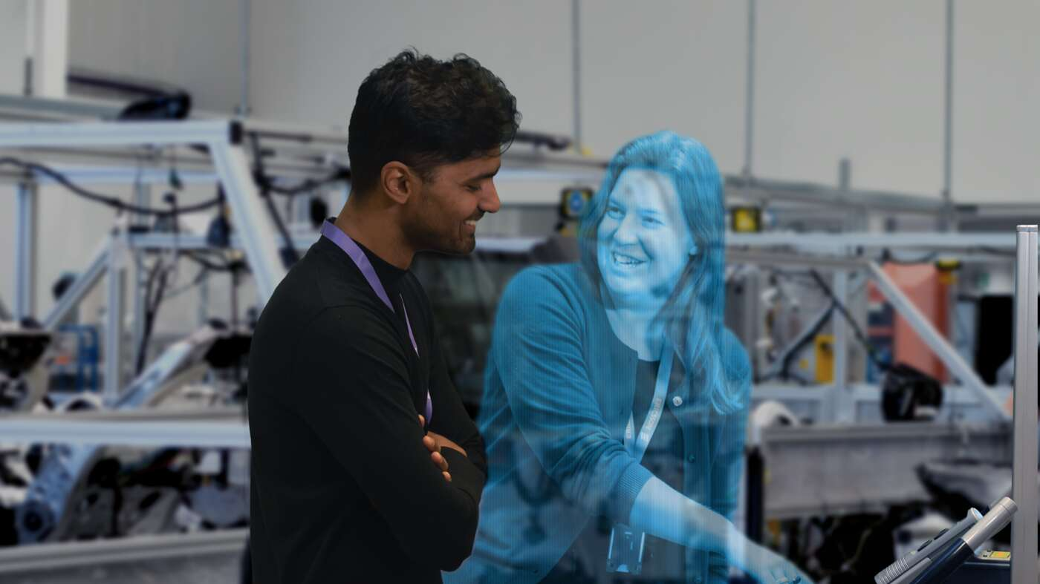

Seniors see benefits with future smart homes
A relevant tech set in a digital senior home to improve senior's life
Home assistant speaker
1 in 4 of seniors already have a remote voice control like Amazon Echo in home to simplify functions in home.
AI and automated consumption
4 in 10 of the seniors would accept at least one type of automated service in their home
3D Hologram calling
6 in 10 young-old seniors 65-74 years are open – not saying no – for new type of communication from their home
Connected 5G Smart Home concept
Bundled smart lighting, thermostats, electricity, water, door locks, surveillance cameras. 4 in 10 seniors interested in this bundled concept.
Source: Ericsson ConsumerLab Analytical platform, Senior study, October 2019
Base: Online population aged 65-74 years within Canada, China, Germany, Italy, Japan, Sweden. UK and US

Slide 13
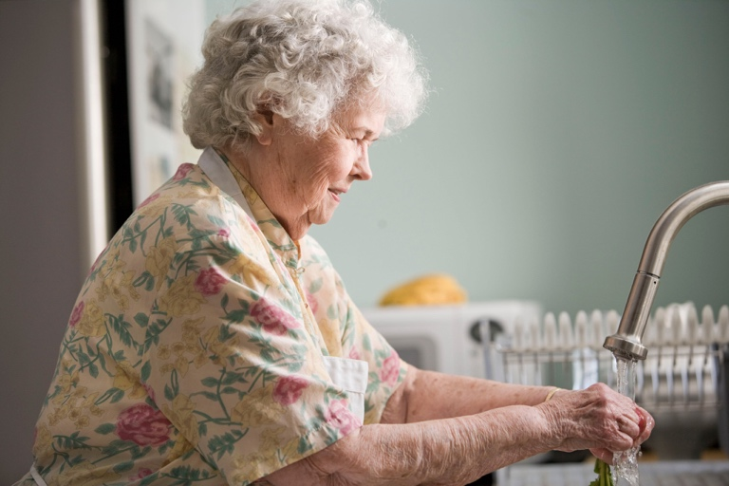
Seniors see challenges with smart home solutions
Personal data
Only 2 in 10 seniors 65+ trust private security companies to treat their personal data.
There is higher trust in mobile operators, but the highest trust is for government/ states
and banks
Lack of quality
4 in 10 seniors 65+ years
who not have an alarm have not installed it they think it wouldn’t make them safer since burglars could brake
in anyway
Trust in AI
Personal data
Lack of quality
Trust in AI
Seniors value the convenience with automated services would but 3 in 10 don´t trust AI. They fear that they will get wrong products ordered by AI. How are decisions made?
Senior smart home product or service
Source: Ericsson ConsumerLab Analytical platform, Senior study, October 2019
Base: Online population aged 65-74 years within Canada, China, Germany, Italy, Japan, Sweden. UK and US

Slide 14
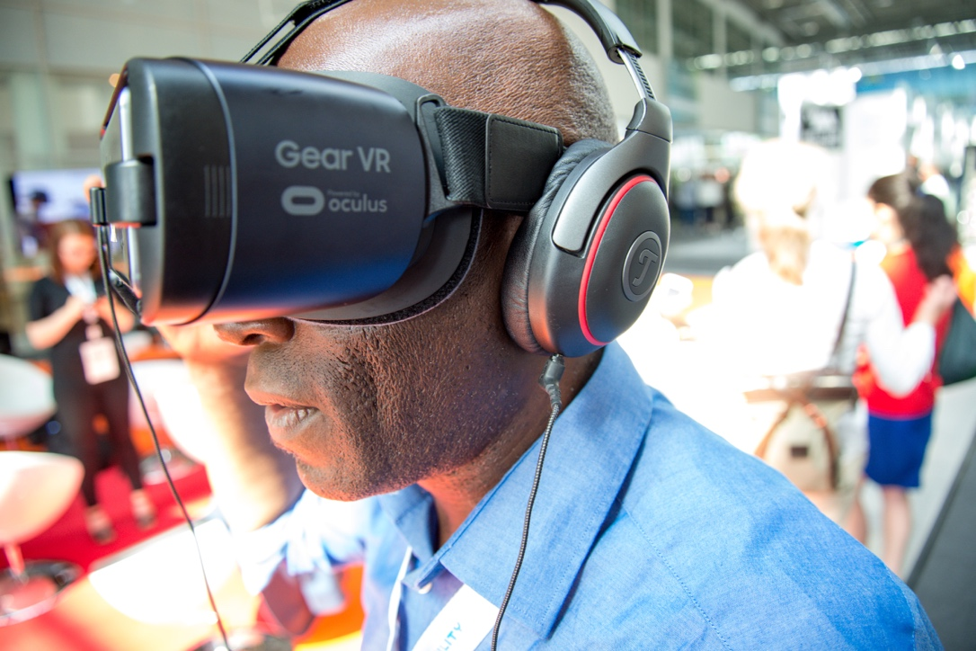
Seniors are curios about AR/VR entertainment
– but utility before pleasure
7 in 10 (8 in 10) seniors 65-74 are interested in at least one of the VR/AR services
Almost half of the seniors 65-74 years are interested in learning a new skill or hobby via VR/AR while 4 in 10 interested in travel virtually
Utility before pleasure since try out sports and play VR games are the least interesting VR activities for seniors
1 in 2
seniors think VR will allow them to have the experiences they want, even if they must be isolated, quarantined or alone
Source: Ericsson ConsumerLab Analytical platform, Senior study, October 2019
Base: Online population aged 65-74 years within Canada, China, Germany, Italy, Japan, Sweden. UK and US

Slide 15
A tricky way to start using (VR/AR) apps
Barriers in ranking order
No time to search and download
High prices on apps
Lack of good apps
1
2
3
4
Low awareness of which apps are in market
6
5
Partner has issues
if using more apps
Difficult to learn how to use apps
Apps are not adapted to elderly
7
8
9
App
Difficult to find and download apps
Have nobody to
ask to get help
Source: Ericsson ConsumerLab Analytical platform, Senior study, October 2019
Base: Online population aged 65-74 years within Canada, China, Germany, Italy, Japan, Sweden. UK and US

Slide 16
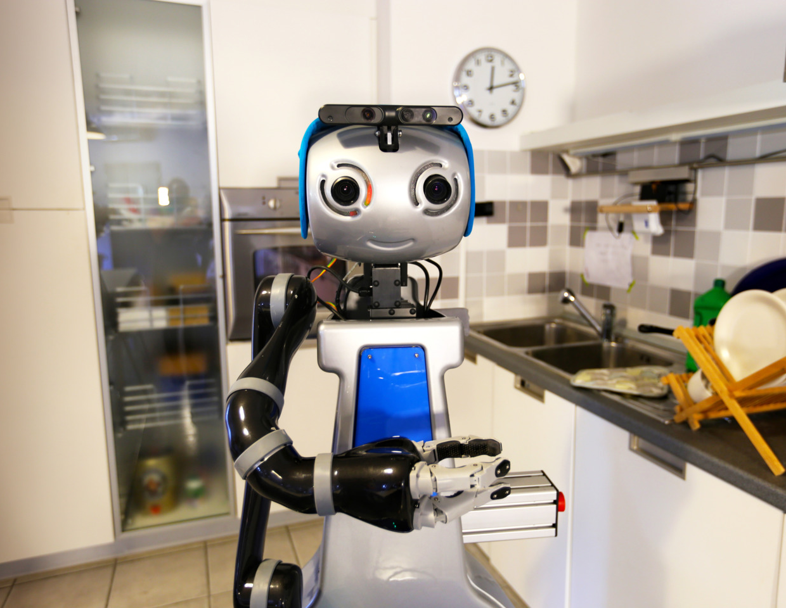
Future companion can be a robot
Seniors who are lonely: 5 in 10 among those who spend most of their time alone – and expect to be lonelier the older they get – show interest for social robots (functions)
Seniors who are tech interested: 6 in 10 seniors in the segment Ageing techies are even more interested in social robots
Source: Ericsson ConsumerLab Analytical platform, Senior study, October 2019
Base: Online population aged 65-74 years within Canada, China, Germany, Italy, Japan, Sweden. UK and US

Slide 17

Many requirements on social robots
When alone
When and what? When alone is the most typical situation to see a robot at home. Also, to let it do boring things – cleaning and making meals.
Seniors mean that robots never will be human enough to socialize with them – and that you can't trust them
Not human enough and no trust
Mobility and intelligence before humor
First drivers: good mobility and intelligence outperforming good vocabulary and humor
Biggest barrier for accepting a social robot is the negative aspect that half simply don’t like robots taking on a human role which half think
A robot should be – a robot
Robot with emotions
Less complicated relationship
Second drivers: 4 in 10 of the seniors also think that the ability to react on emotions and being able to show emotions are important
Third drivers: 2 in 10 also mention that a robot is easy to have a good relationship with, and will never you leave you
Source: Ericsson ConsumerLab Analytical platform, Senior study, October 2019
Base: Online population aged 65-74 years within Canada, China, Germany, Italy, Japan, Sweden. UK and US
Barriers
Drivers

Slide 18
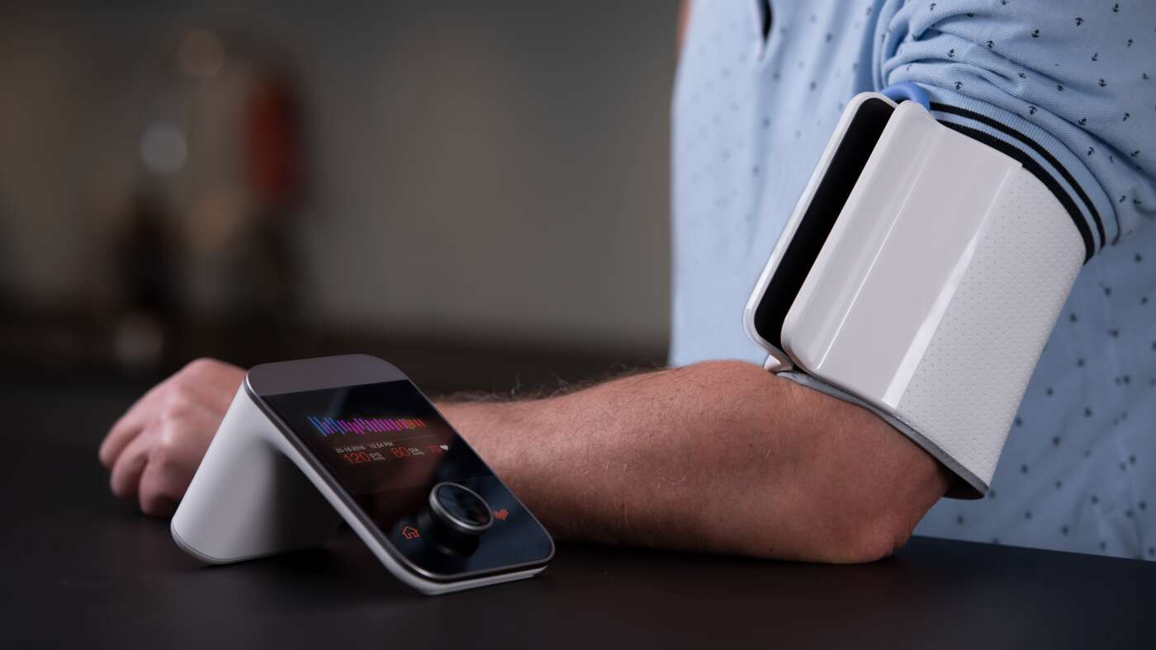

A reliable network has played an important roll during crisis for exercise and health
Online health videos to replace or complement going to gym
3 in 10 seniors 65-74 years think online health activities could replace or supplement going to the gym even after that the Coronavirus crisis has been resolved
Increased usage of health consultation apps
3 in 10 have downloaded any type of Corona app due to the crisis. Also, now 2 in 10 among seniors use remote health consultation apps. But less common then among all consumers.
Increased purchases of medical supplies online
Half of seniors 65-74 years buy medical supplies online at least monthly on their smartphone. Also, 1 in 5 have started/ increased this purchase due to crisis.
Base: Smartphone users aged 65–74 within Brazil, China, France, Germany, India, Italy, South Korea, Spain, Sweden, UK and US Source: Ericsson Consumer & IndustryLab, Keeping consumer connected in a COVID-19 context (Mid-April 2020)

Slide 19
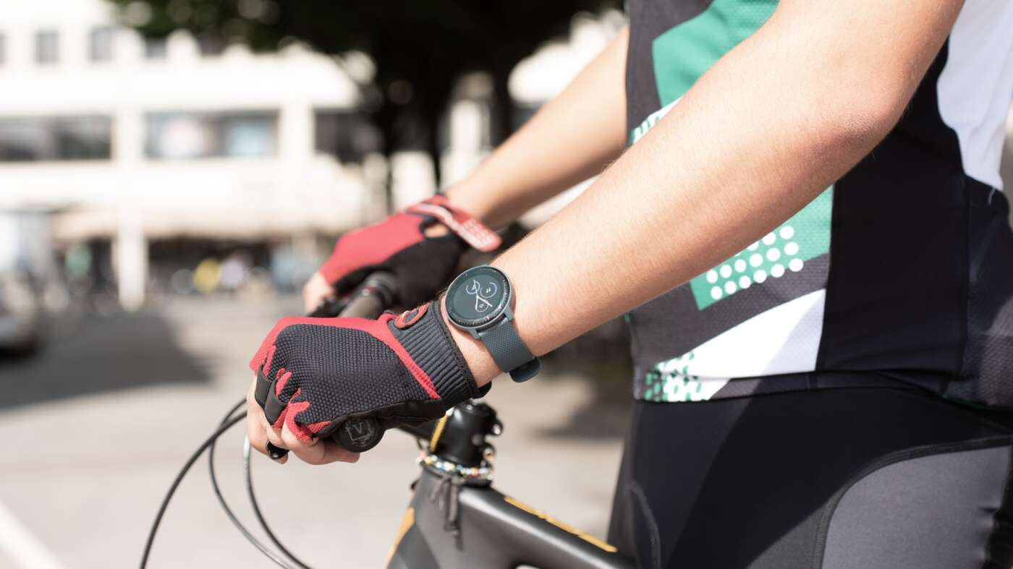

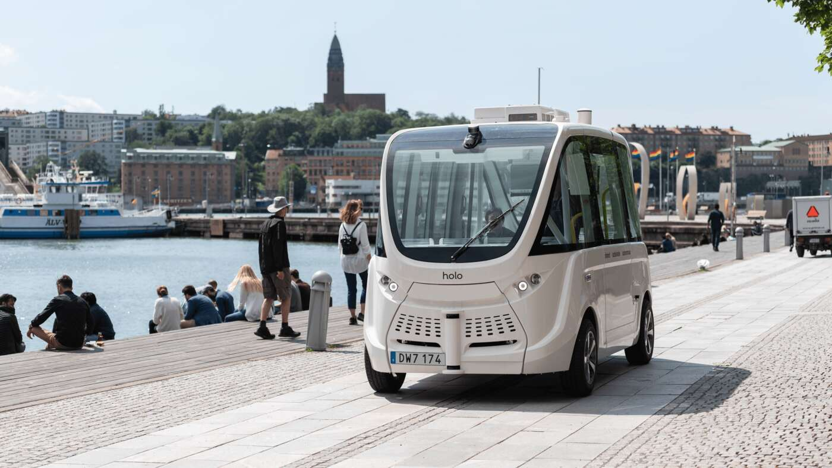

Seniors expect new technologies to advance in health
5G health wearables to keep track
Virtual telehealth appointments
Autonomous clinic to pop up outside
Intelligent health robots in hospitals
1 in 2
of the seniors 65-74 are very interested in a 5G health wearable monitoring heart rate and works as emergency alarm, for security reason, but also to measure skin temperature, check respiration, blood pressure and data predicting the onset of infection or inflammation.
38 %
of seniors 65-74 totally agree that on-line healthcare consultations will become more popular than physicals visits to the doctor, and 1 in 4 are positive to set up these virtual appointments automatically based on the outcome of their health tracker
1 in 3
think that instead of going to a medical clinic, they would love the opportunity to be able to call for an autonomous clinic to ‘pop up’ outside my door (where they could leave blood samples etc.)
About half
of those 65-74 years believe intelligent health robots could help take care of patients in the hospital taking measurements, reducing the amount of time medical staff need to spend with infectious patients.
Source: Ericsson ConsumerLab Analytical platform, Senior study, October 2019
Base: Online population aged 65-74 years within Canada, China, Germany, Italy, Japan, Sweden. UK and US

Slide 20
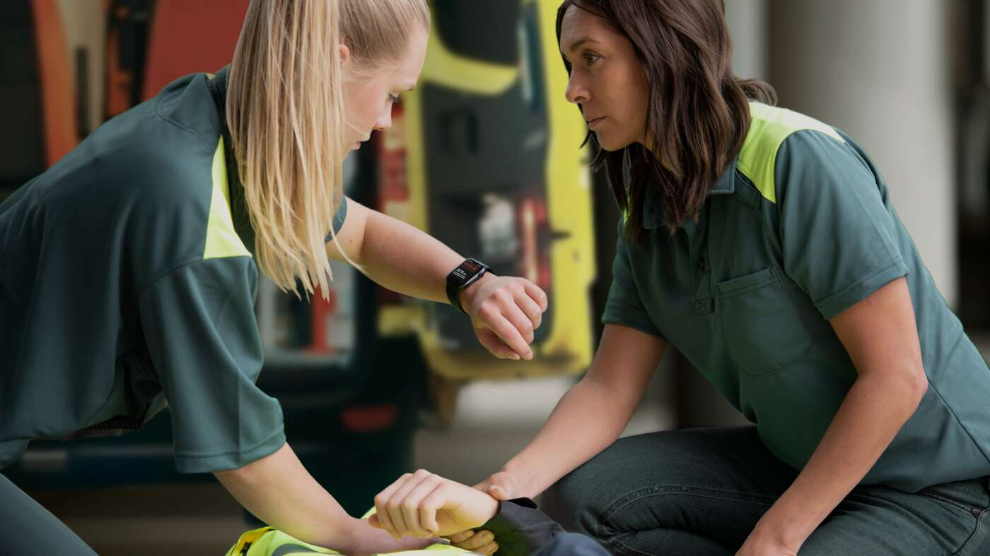
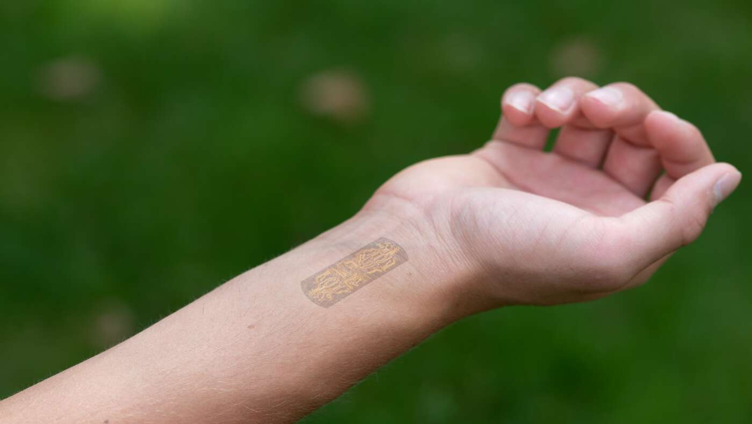
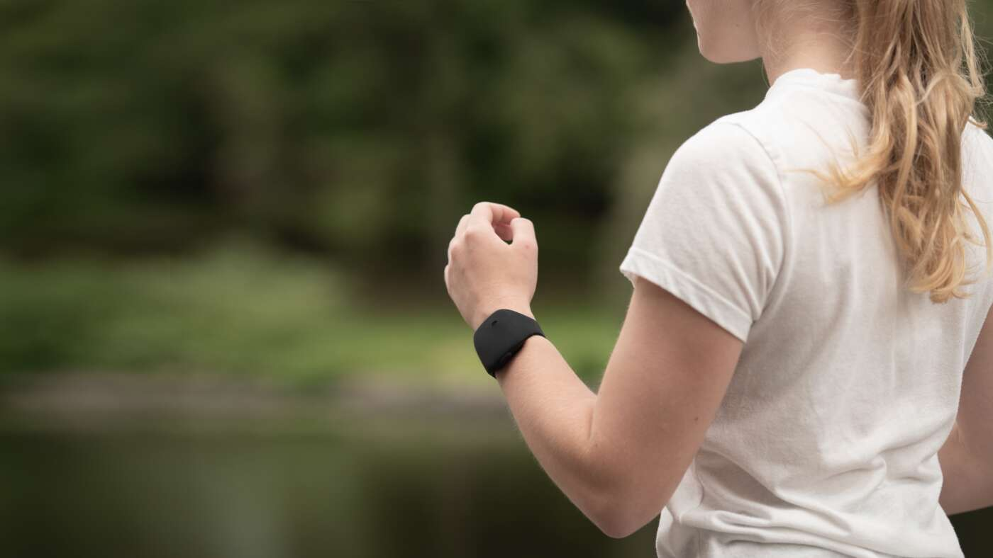
Health wearables to meet seniors’ actual needs
Not-visible sensors – closest to needs
Almost 1 in 4 senior are interested in a health wearable not visible (under skin or clothes)
On-body devices – closer to needs
But 2 in 3 also say something else like than wristband; earring, glasses, contact lenses, or devices on clothes or skin – since more due to needs
Development of current wristband – close to needs
As many as 3 in 4 spontaneously choose a type of wristband – close to something they are used to (watch or fitness band). And those using fitness band are more interested in future health devices
Light-weighted
Easy to use/wear
Easy to keep clean
Discrete
Needs in order of importance
Source: Ericsson ConsumerLab Analytical platform, Senior study, October 2019
Base: Online population aged 65-74 years within Canada, China, Germany, Italy, Japan, Sweden. UK and US

Slide 21
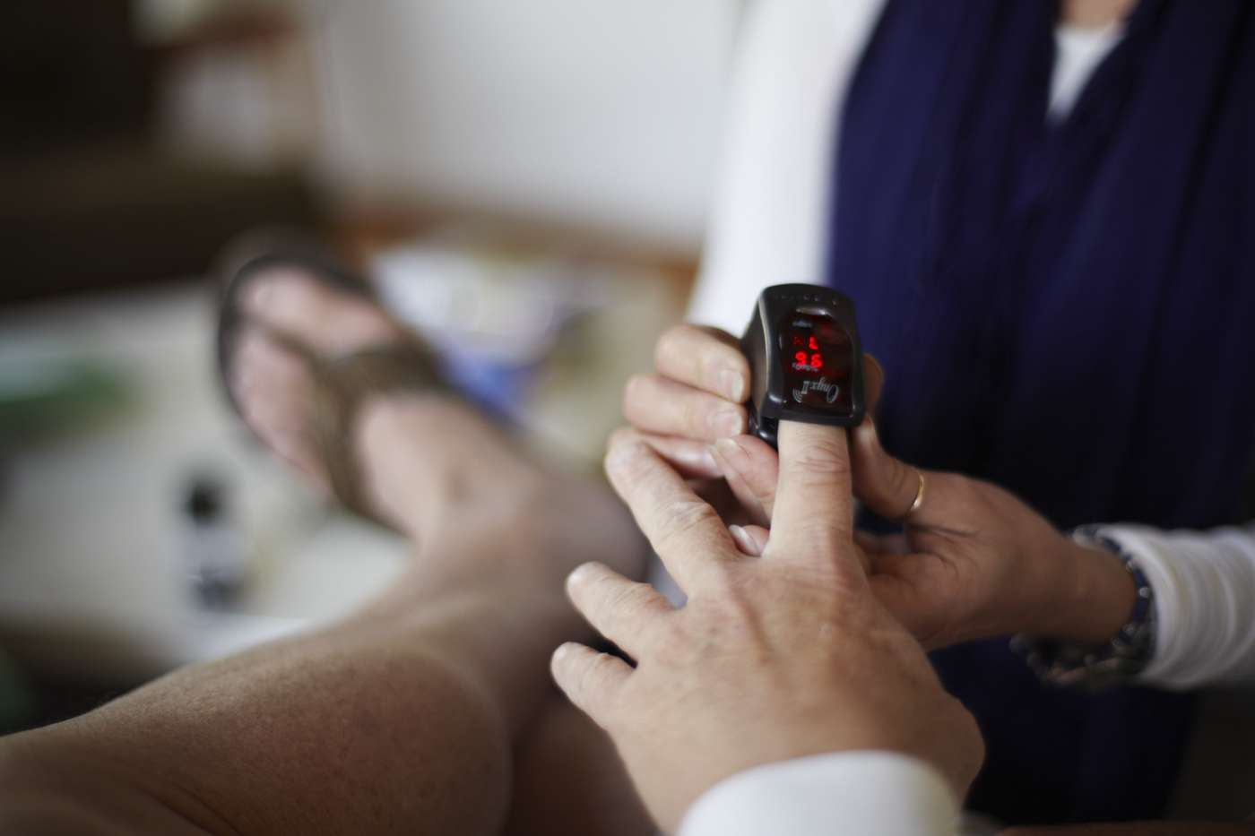

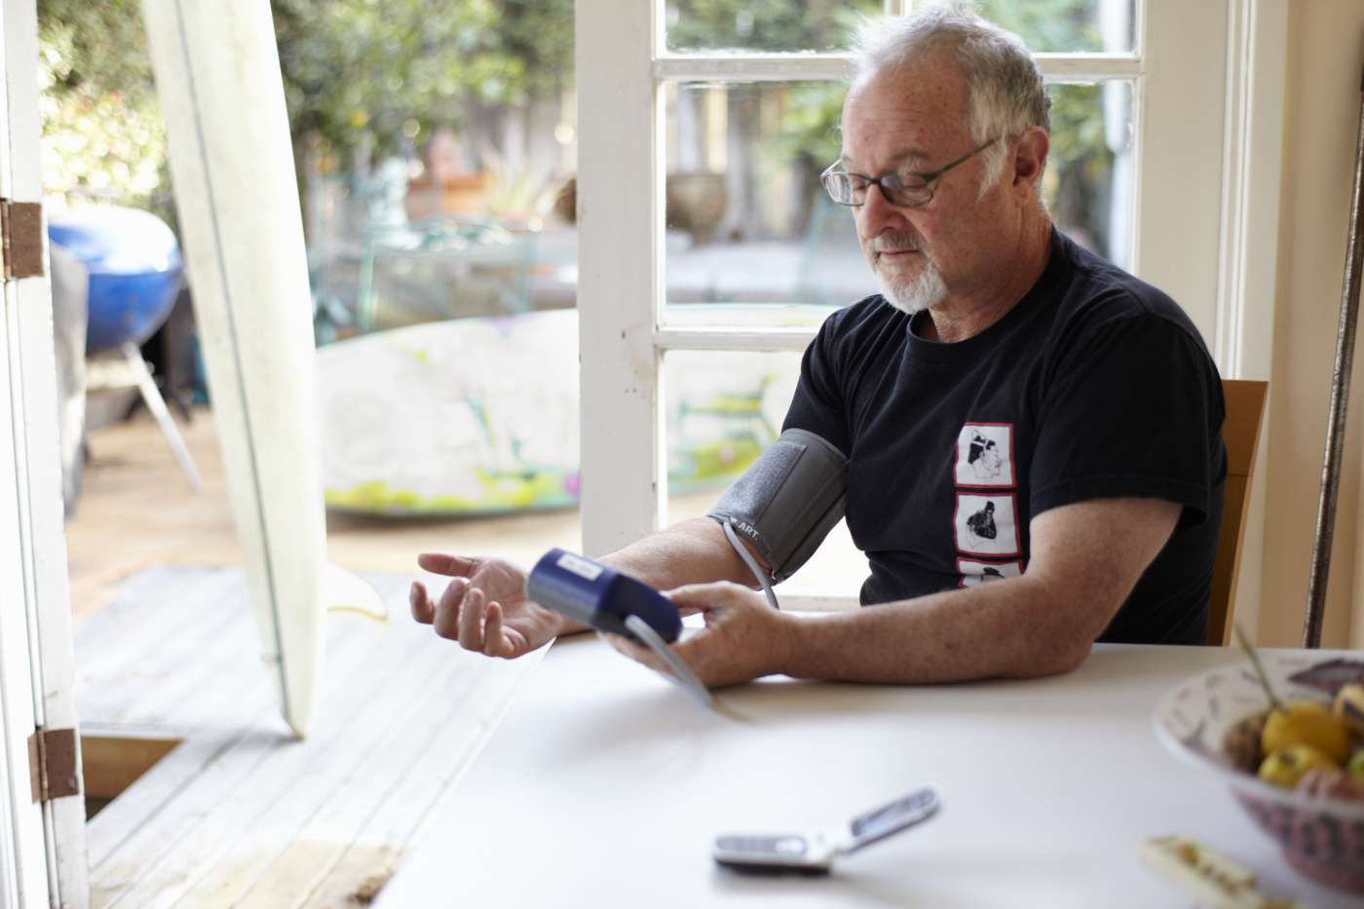
Should a reliable network for seniors be on the public health agenda?
7 in 10
of seniors 65-74 strongly believe communication technology is a good way for elderly people to overcome a crisis like this
One step further
for a digital health
life for seniors
Reliable network for seniors on the public health agenda?
3 in 4
among seniors 65-74 years
agree that being connected to
the Internet is more important to them nowadays
1 in 2
of seniors 65-74 years say they wish 5G was rolled out faster during crisis
Base: Smartphone users aged 65–74 years within Brazil, China, France, Germany, India, Italy, South Korea, Spain, Sweden, UK and US
Source: Ericsson Consumer & IndustryLab, Keeping consumer connected in a COVID-19 context (Mid-April 2020)

