Slide 1
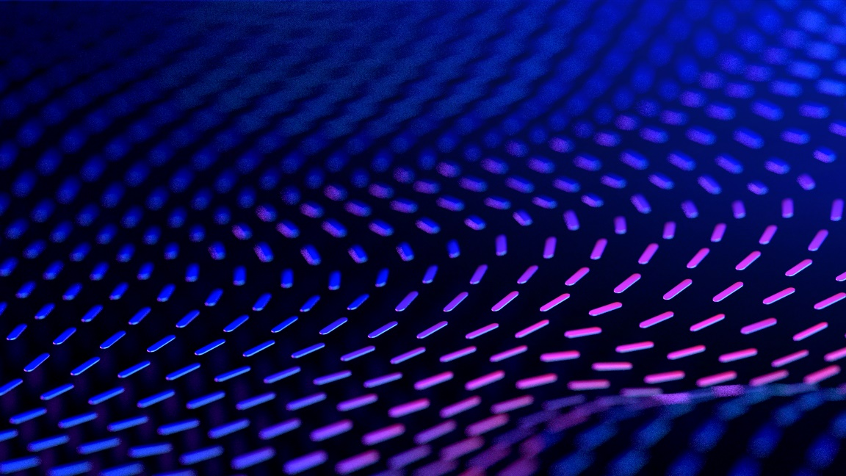

Curriculum Connect
Summer
Underwater Game
Visual Assets: https://scratch.mit.edu/
Scratch is a project of the Scratch Foundation, in collaboration with the Lifelong Kindergarten Group at the MIT Media Lab. It is available for free at https://scratch.mit.edu

Slide 2
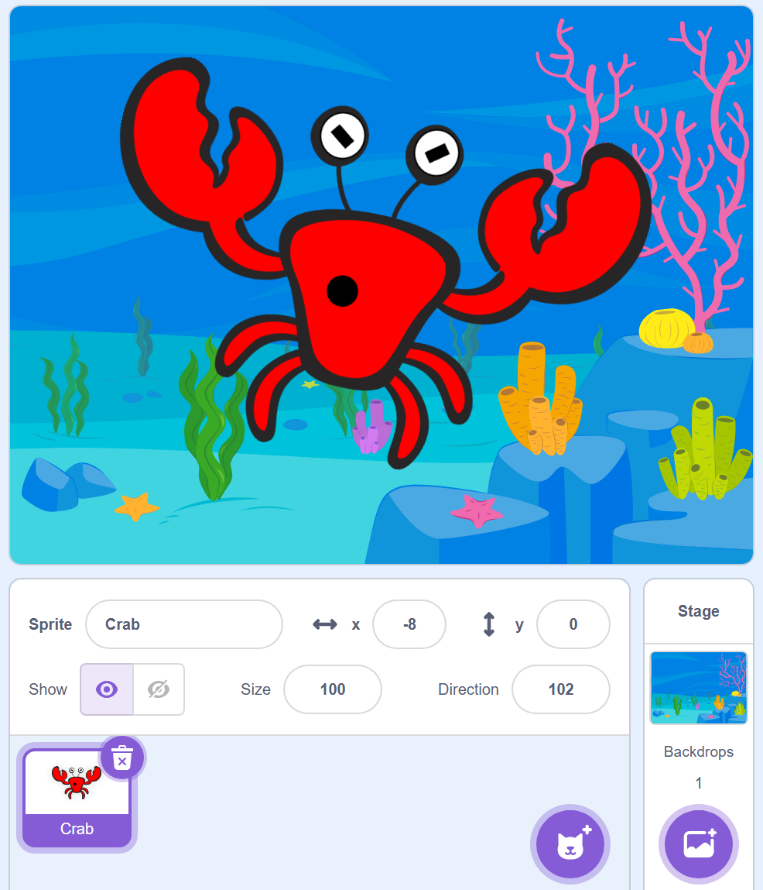
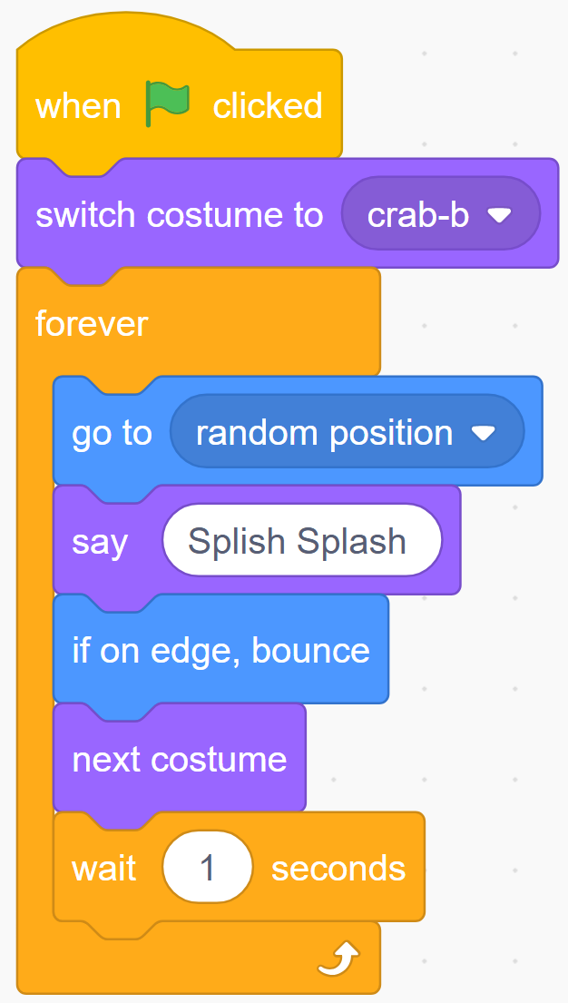
Underwater Crab – Level 1 – Part 1 Curriculum Connect: Summer. STEM - Technology – coding.
Stage and Sprites
Code – Crab
Select when green flag clicked block
Select switch costume to block and choose crab-b
Select forever block
Select go to random position block
Select say Hello!, change "Hello!" to "Splish Splash"
Select next costume block
Select the wait block and change it to 1 second
Select the underwater stage
Add the "crab" sprite
Scratch is a project of the Scratch Foundation, in collaboration with the Lifelong Kindergarten Group at the MIT Media Lab. It is available for free at https://scratch.mit.edu

Slide 3
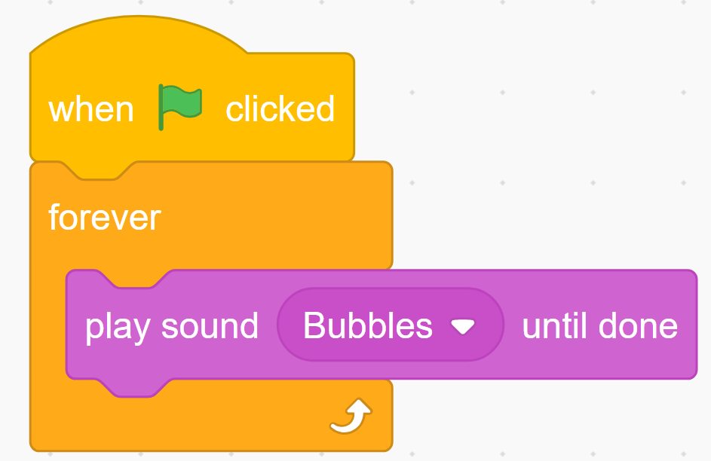
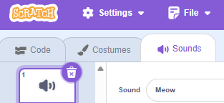

Underwater Crab – Level 1 – Part 2 Curriculum Connect: Summer. STEM - Technology – coding.
Code - Crab
Select when green flag clicked block
Select forever block
Select the play sound Bubbles until done
Select "Bubbles" sound by clicking the sound tab then the sound icon and search "bubbles" sound.
Scratch is a project of the Scratch Foundation, in collaboration with the Lifelong Kindergarten Group at the MIT Media Lab. It is available for free at https://scratch.mit.edu

Slide 4
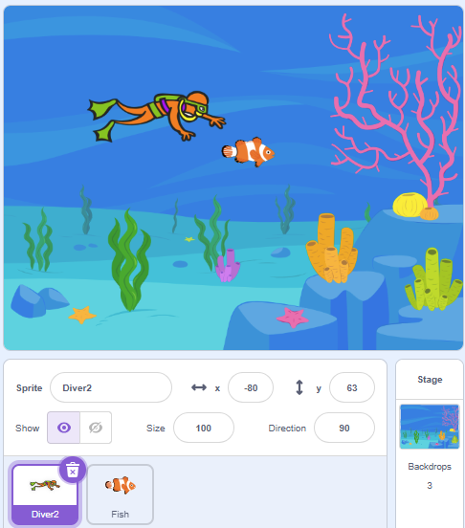
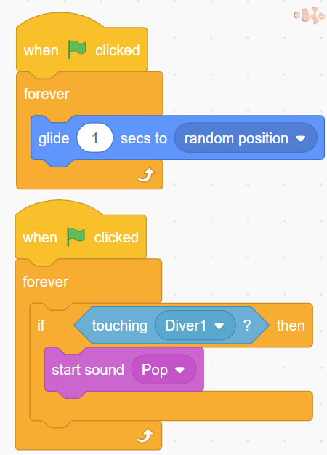
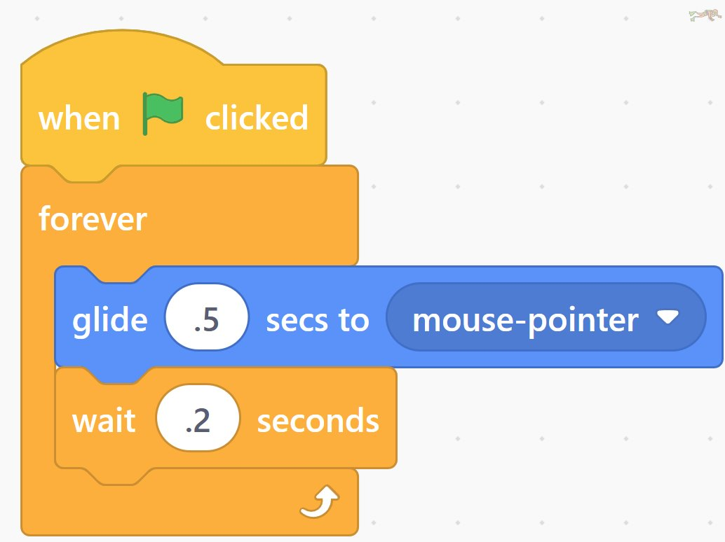

Underwater Game Catch the Fish – Level 2 – Part 1 Curriculum Connect: Summer. STEM - Technology – coding.
Stage and Sprites
Code – Diver
Code - Fish
Under Sensing, find the “touching” block. Add this to the if statement.
Click on the "Diver"
Select when green flag clicked block
Select forever block
Add the following glide motion:
Change “random position” to “Mouse-pointer”. The mouse pointer is your finger on a tablet.
Select the Underwater Stage
Add “Diver” and “Fish” Sprites
If the diver is touching the fish play a Pop sound.
Scratch is a project of the Scratch Foundation, in collaboration with the Lifelong Kindergarten Group at the MIT Media Lab. It is available for free at https://scratch.mit.edu

Slide 5
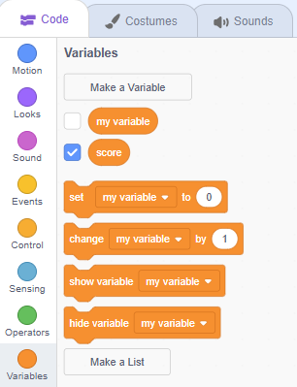
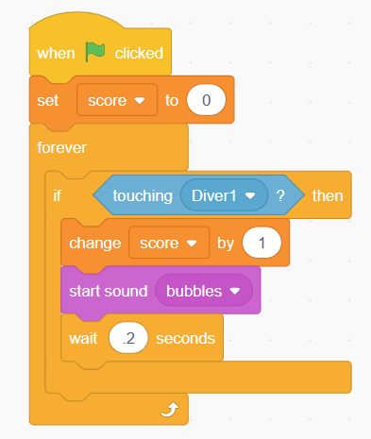
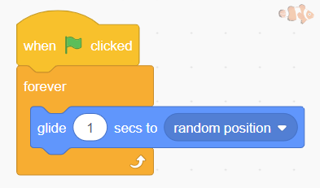
Underwater Game Catch the Fish – Level 2 – Part 2 Add The Score to your game
Code – Make a Variable
Code – Add scoring to the Fish Code
Under Variables, find the “Set my variables to 0” block.
Change “my variable” to “score”
Create a variable and call it score.
Scratch is a project of the Scratch Foundation, in collaboration with the Lifelong Kindergarten Group at the MIT Media Lab. It is available for free at https://scratch.mit.edu

Slide 6
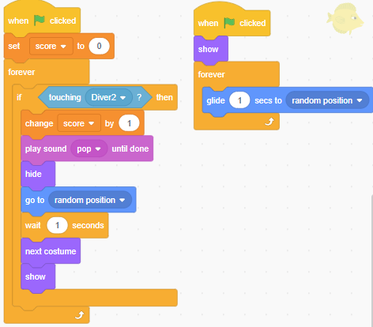
Underwater Game – Level 3 – Part 1 Adding extra features to your game! Changing Fish
Add to Code – Fish
Open the Fish Code
If the Diver touches the fish
Change score by 1
Hide the fish
Go to Random Position
Change the costume, so it looks like a new fish
Show the fish
Scratch is a project of the Scratch Foundation, in collaboration with the Lifelong Kindergarten Group at the MIT Media Lab. It is available for free at https://scratch.mit.edu

Slide 7
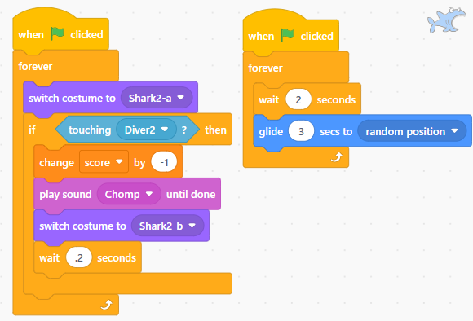
Underwater Game – Level 3 – Part 2 Adding an Enemy to your game!
Code – Shark
Start with the Closed Mouth Costume
If the Shark touches the diver
Change score by -1
Change the costume, so it looks like the Shark is biting
Scratch is a project of the Scratch Foundation, in collaboration with the Lifelong Kindergarten Group at the MIT Media Lab. It is available for free at https://scratch.mit.edu

