Slide 1


Curriculum Connect
Coordinates
Visual Assets: https://scratch.mit.edu/
Scratch is a project of the Scratch Foundation, in collaboration with the Lifelong Kindergarten Group at the MIT Media Lab. It is available for free at https://scratch.mit.edu

Slide 2

What are Coordinates?
Curriculum Connect: STEM - Technology – coding, mathematics, geography
Coordinates are like a secret code to find a place on a map or grid.
It’s like giving directions first one way, then the other!
Two numbers (x, y) tell us exactly where to go.
In maths, we call the first number the X coordinate (across) and the second number the Y coordinate (up and down).
Scratch is a project of the Scratch Foundation, in collaboration with the Lifelong Kindergarten Group at the MIT Media Lab. It is available for free at https://scratch.mit.edu

Slide 3
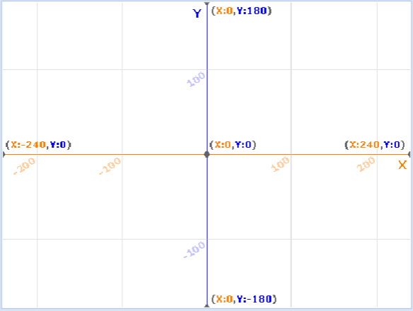
Meet the Map
Curriculum Connect: STEM - Technology – coding, mathematics, geography
This is a coordinate plane.
Horizontal line = X-axis
Vertical line = Y-axis.
The point where they cross is called the origin (0,0) the starting point of every adventure!
Numbers go right and up for positive coordinates.
Numbers go left and down for negative coordinates.
X-axis
Origin
Y-axis
Scratch is a project of the Scratch Foundation, in collaboration with the Lifelong Kindergarten Group at the MIT Media Lab. It is available for free at https://scratch.mit.edu

Slide 4
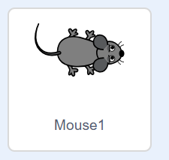
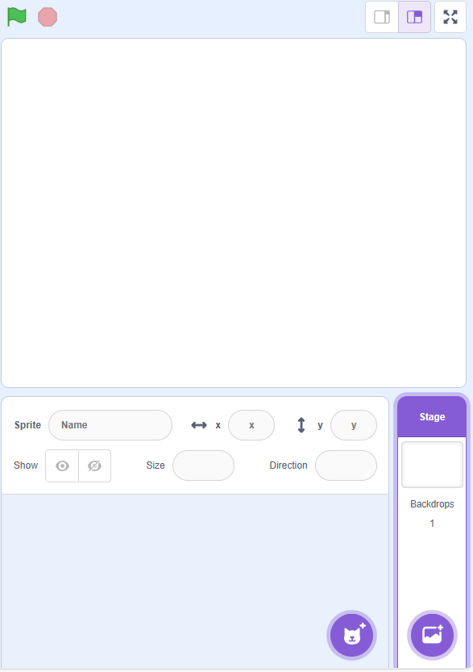
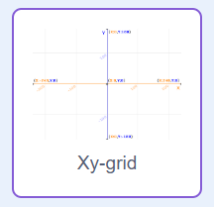
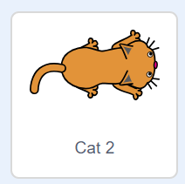
Coordinates – Step 1
Curriculum Connect: STEM - Technology – coding, mathematics, geography
This game involves the coordinate plane as a background and two sprites a cat and a mouse.
Add Background
Add Sprites
Scratch is a project of the Scratch Foundation, in collaboration with the Lifelong Kindergarten Group at the MIT Media Lab. It is available for free at https://scratch.mit.edu

Slide 5
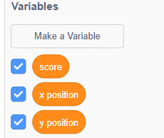
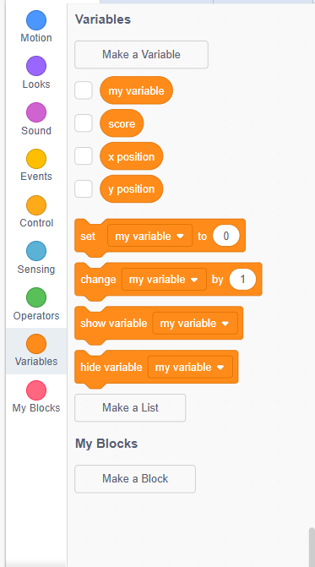
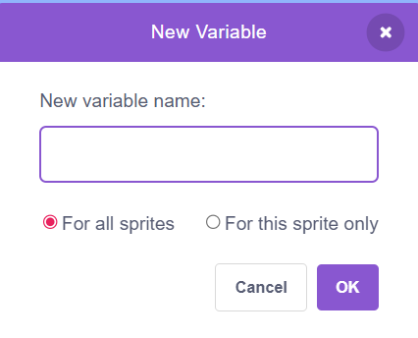
Coordinates– Step 2
Curriculum Connect: STEM - Technology – coding, mathematics, geography
  Code – Make a Variable
We will make three variables two of them are our unknown coordinates and the third is the score.
Create three variables with these names when they are created, they should look like this in the variable section. We want to tick the boxes, so they show up on the screen.
Scratch is a project of the Scratch Foundation, in collaboration with the Lifelong Kindergarten Group at the MIT Media Lab. It is available for free at https://scratch.mit.edu

Slide 6
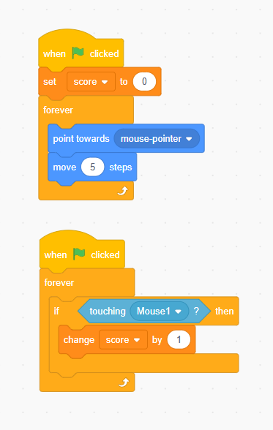
Coordinates– Step 3
Curriculum Connect: STEM - Technology – coding, mathematics, geography
  Code
This the code for the cat.
1. Setting the score to 0 when the game starts.
2. Getting the cat to forever point towards the mouse and move 5 steps, this creates the cats movement and how the player will catch the mouse.
3. An if statement that if the cat has caught the mouse the player gets a point added to their score.
Scratch is a project of the Scratch Foundation, in collaboration with the Lifelong Kindergarten Group at the MIT Media Lab. It is available for free at https://scratch.mit.edu

Slide 7
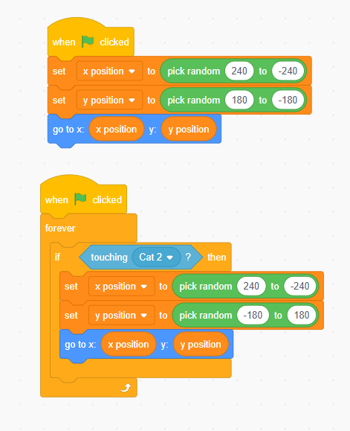
Coordinates– Step 4
Curriculum Connect: STEM - Technology – coding, mathematics, geography
  Code
This the code for mouse.
1. This sets our variables as random numbers between the range of values our coordinate plane has.
2. Make the mouse go to them random coordinates.
3. Forever if the cat catches the mouse.
4. New random coordinates will be picked
5. And the mouse will go to them.
Scratch is a project of the Scratch Foundation, in collaboration with the Lifelong Kindergarten Group at the MIT Media Lab. It is available for free at https://scratch.mit.edu

Slide 8
Curriculum Connect
Mathematics
Visual Assets: https://scratch.mit.edu/
Scratch is a project of the Scratch Foundation, in collaboration with the Lifelong Kindergarten Group at the MIT Media Lab. It is available for free at https://scratch.mit.edu

Slide 9
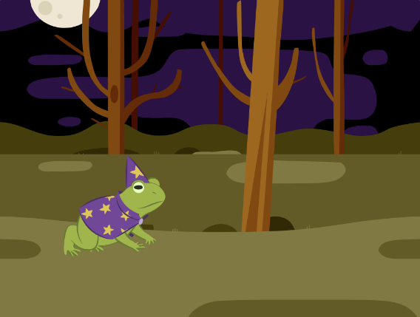
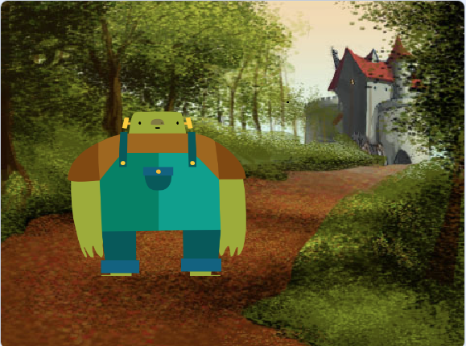
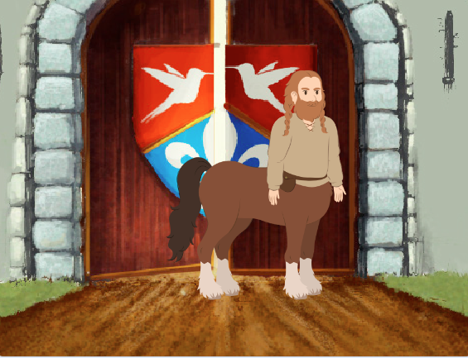
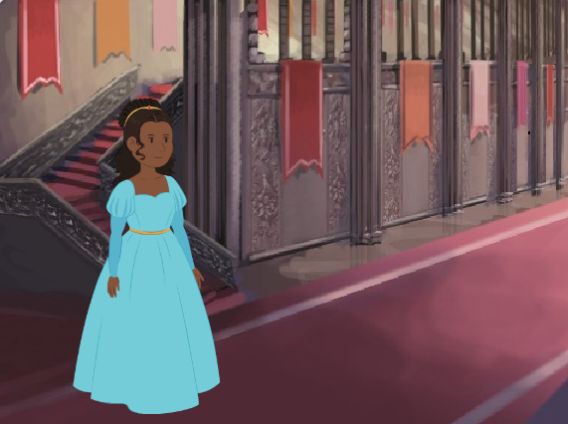
Maths– Step 1
Curriculum Connect: STEM - Technology – coding, story telling, mathematics
This game involves creating a storyline with sprites and backgrounds.
For my game, the story is you are travelling through a forest to get to a castle with a princess.
To create this story, I had to add backgrounds and sprites.
These are the sprites and backgrounds that I choose to tell my story.
Add Sprites
Add Background
Scratch is a project of the Scratch Foundation, in collaboration with the Lifelong Kindergarten Group at the MIT Media Lab. It is available for free at https://scratch.mit.edu

Slide 10
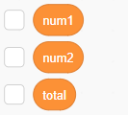
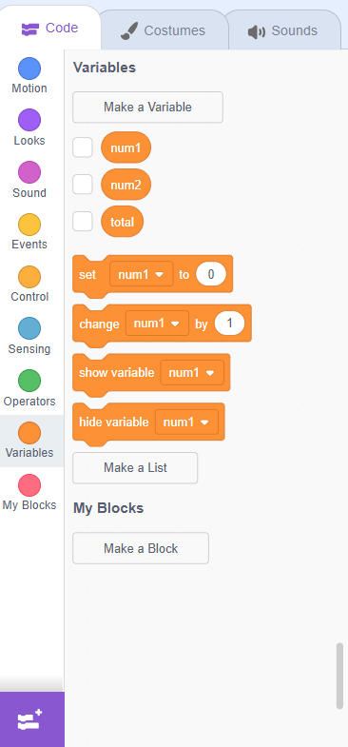
Maths – Step 2
Curriculum Connect: STEM - Technology – coding, story telling, mathematics
  Code – Make a Variable
We will make three variables two of them are our unknown numbers and the third is the answer to the question
Create three variables with these names when they are created, they should look like this in the variable section.
Scratch is a project of the Scratch Foundation, in collaboration with the Lifelong Kindergarten Group at the MIT Media Lab. It is available for free at https://scratch.mit.edu

Slide 11
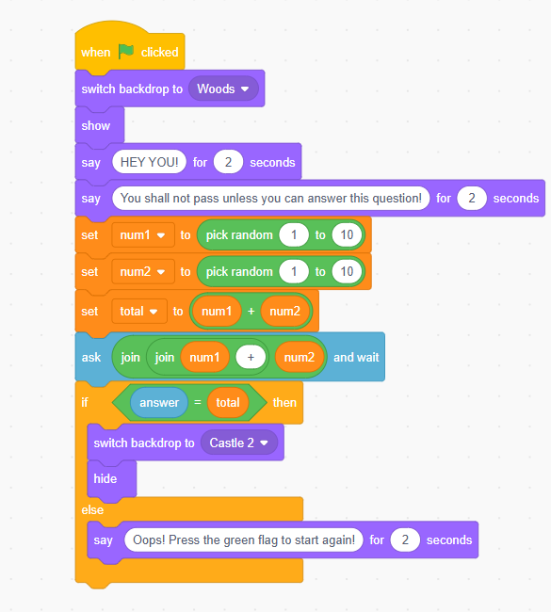
Maths – Step 3
Curriculum Connect: STEM - Technology – coding, story telling, mathematics
  First Character
This is the code for the first character of the story.
1. Setting the number variable as a random number between 1 and 10.
2. Setting the total variable as the two random numbers added together
3. Ask the user for the answer
4. An if statement to continue the game if they answer the total correctly or tell them to restart if they get it incorrect.
5. If the answer is correct switch the backdrop to the next scene of your game. Then the character hides so the next character can appear
Scratch is a project of the Scratch Foundation, in collaboration with the Lifelong Kindergarten Group at the MIT Media Lab. It is available for free at https://scratch.mit.edu

Slide 12
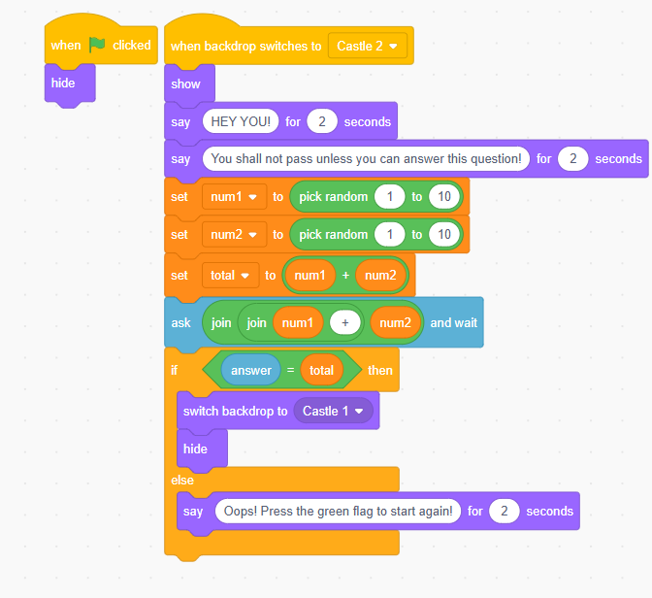
Maths – Step 4
Curriculum Connect: STEM - Technology – coding, story telling, mathematics
This the code for the second character of the story.
  Second character
1. Hides the character until its their scene
2. To make this level more difficult you can change the range for the random number to be higher or change the operation.
4. Switch to the next backdrop
3. If you change the operation at 2 then change it here too
Scratch is a project of the Scratch Foundation, in collaboration with the Lifelong Kindergarten Group at the MIT Media Lab. It is available for free at https://scratch.mit.edu

Slide 13
Maths – Step 5
Curriculum Connect: STEM - Technology – coding, story telling, mathematics
This the code for the third character of the story.
  Third character
1. Hides the character until its their scene
2. To make this level more difficult you can change the range for the random number to be higher or change the operation.
4. Switch to the next backdrop
3. If you change the operation at 2 then change it here too
Scratch is a project of the Scratch Foundation, in collaboration with the Lifelong Kindergarten Group at the MIT Media Lab. It is available for free at https://scratch.mit.edu

Slide 14
Maths – Step 6
Curriculum Connect: STEM - Technology – coding, story telling, mathematics
This the code for the fourth character of the story.
  Fourth character
1. Hides the character until it's their scene
2. To make this level more difficult you can change the range for the random number to be higher or change the operation.
4. Switch to the next backdrop
3. If you change the operation at 2 then change it here too
Scratch is a project of the Scratch Foundation, in collaboration with the Lifelong Kindergarten Group at the MIT Media Lab. It is available for free at https://scratch.mit.edu

