Slide 1


Curriculum Connect
Merry Christmas
Nollaig Shona Duit
Visual Assets: https://scratch.mit.edu/
Scratch is a project of the Scratch Foundation, in collaboration with the Lifelong Kindergarten Group at the MIT Media Lab. It is available for free at https://scratch.mit.edu

Slide 2
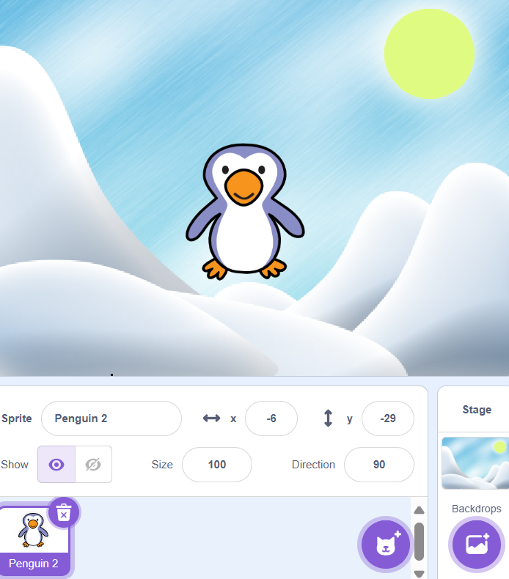
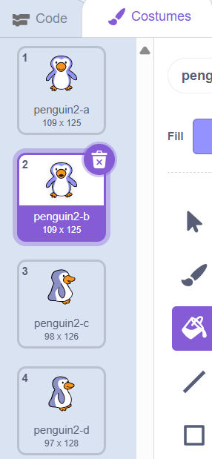
Merry Christmas – Level 1 (Part 1)
Curriculum Connect: Merry Christmas
Stage and Sprites
Changing costumes for sprite
Change to “Penguin2-b and click on it.
You should now edit this costume.
This costume will change, when you use code.
Add “Penguin” sprite
Choose a backdrop
Scratch is a project of the Scratch Foundation, in collaboration with the Lifelong Kindergarten Group at the MIT Media Lab. It is available for free at https://scratch.mit.edu

Slide 3
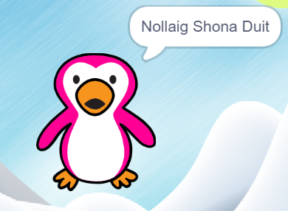
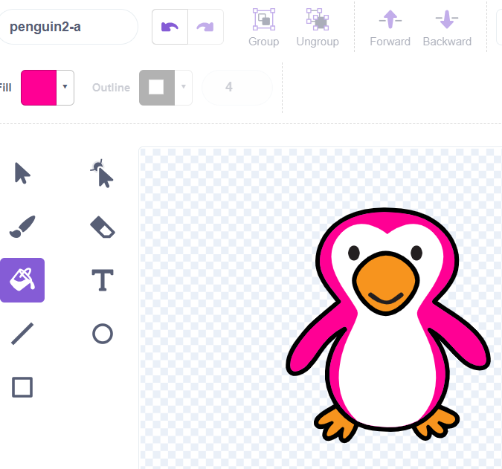
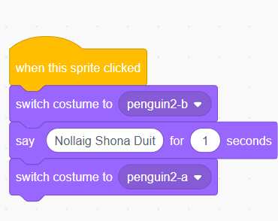
Merry Christmas – Level 1 (Part 2)
Edit sprite
Code for sprite
This is the code, making the penguin change costume when clicked, and saying “Nollaig Shona Duit”
For each costume
Select Fill Bucket and select Fill Colour
Click the part of the body of that penguin, to change the colour of that body part.
Scratch is a project of the Scratch Foundation, in collaboration with the Lifelong Kindergarten Group at the MIT Media Lab. It is available for free at https://scratch.mit.edu

Slide 4
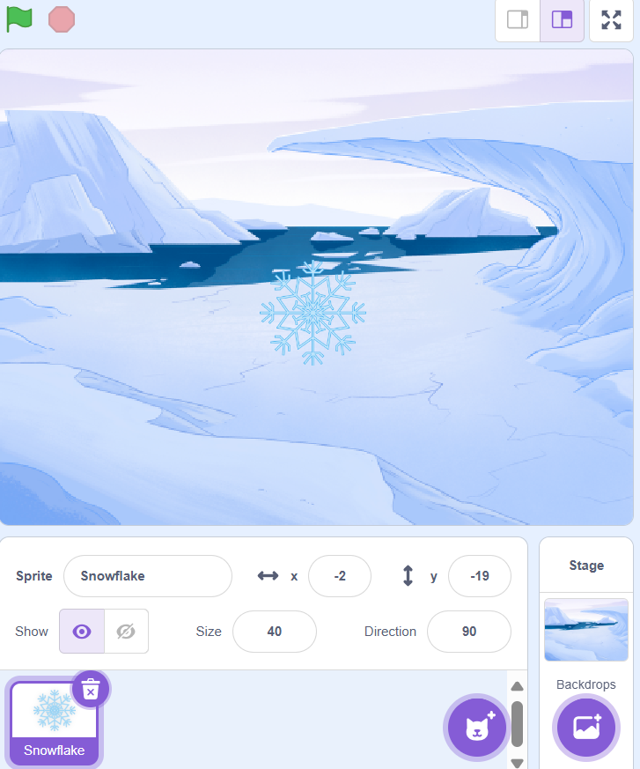
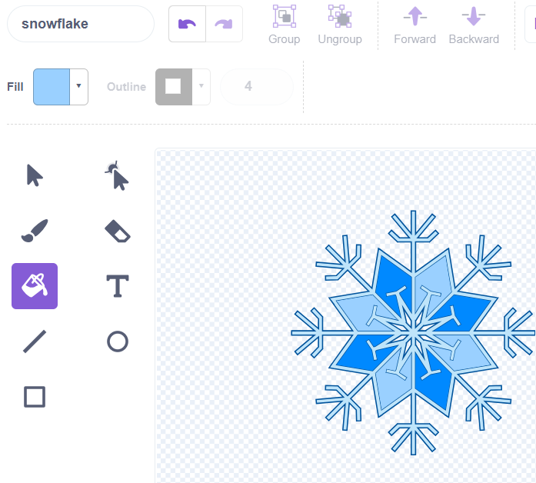
Merry Christmas – Level 2 (Part 1)
Catch the Snowflakes!
Stages and Sprites
Edit Snowflake
Make sure you set the size of the sprite to 40!
For each Costume​
Select Fill Bucket and set the Fill Colour.​
Click any part of the snowflake to to change the colour.
Select the Artic Stage
Add “Snowflake” sprite
Scratch is a project of the Scratch Foundation, in collaboration with the Lifelong Kindergarten Group at the MIT Media Lab. It is available for free at https://scratch.mit.edu

Slide 5
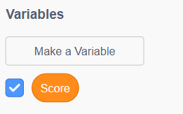
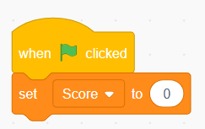

Merry Christmas – Level 2 (Part 2)
Catch the Snowflakes!
Making a Variable
Score Board- Code
Example
To make the score variable:
Go to variables
Click make a variable
And type in Score
When the green flag is clicked a score board should appear on the screen
This should then appear in the top left!
Scratch is a project of the Scratch Foundation, in collaboration with the Lifelong Kindergarten Group at the MIT Media Lab. It is available for free at https://scratch.mit.edu

Slide 6
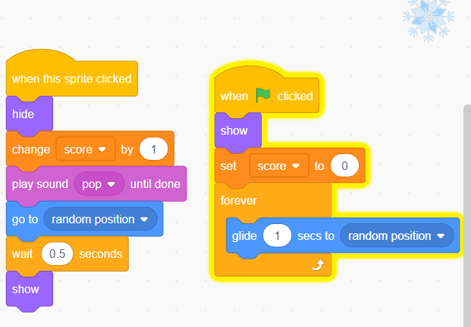
Merry Christmas – Level 2 (Part 3)
Code For Sprite
When the green flag is clicked:
The snowflake appears – show
The score starts at 0 – set score to 0
The snowflake moves around the screen – forever glide to random position
When the Snowflake is clicked:
The snowflake hides – hide
You get 1 point – change score by 1
It plays a sound – play sound pop
It goes to a new place – go to random position
Waits 0.5 seconds – wait 0.5 seconds
Then shows again - show
Scratch is a project of the Scratch Foundation, in collaboration with the Lifelong Kindergarten Group at the MIT Media Lab. It is available for free at https://scratch.mit.edu

Slide 7
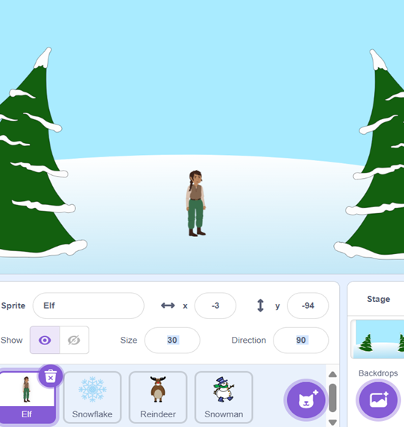
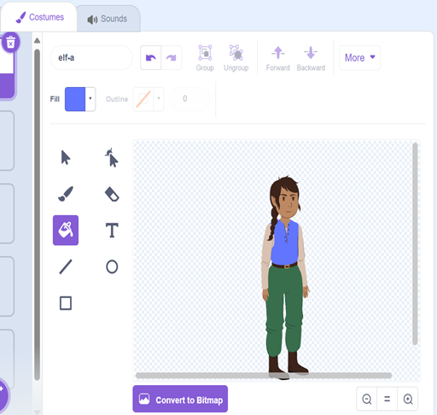
Merry Christmas – Level 3 (Part 1)
Elf Game – catch the falling sprites!
Stages and Sprites
Edit Sprite
Choose a sprite in the bottom right corner
For each costume
Select Fill Bucket and select Fill Colour
Click the part of the body of that elf, to change the colour of that body part.
Select a Stage
Add “Elf” Sprite
Set the size of the elf to 30
Scratch is a project of the Scratch Foundation, in collaboration with the Lifelong Kindergarten Group at the MIT Media Lab. It is available for free at https://scratch.mit.edu

Slide 8


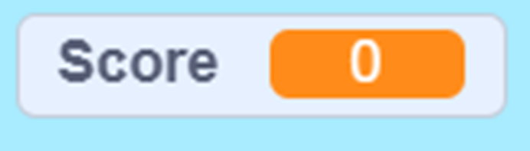
Merry Christmas– Level 3 (Part 2)
Elf Game – catch the falling sprites!
Making a Variable
Score Board- Code
Example
To make the score variable:
Go to variables
Click make a variable
And type in Score
When the green flag set the score to 0
This should then appear in the top left!
Scratch is a project of the Scratch Foundation, in collaboration with the Lifelong Kindergarten Group at the MIT Media Lab. It is available for free at https://scratch.mit.edu

Slide 9
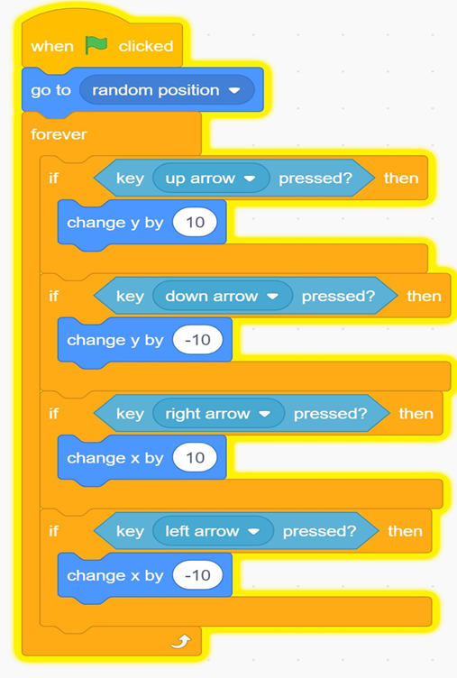
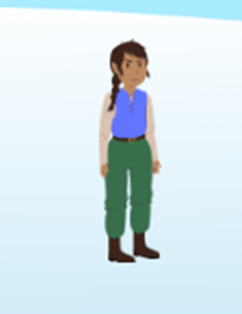
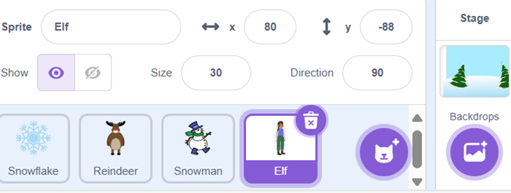
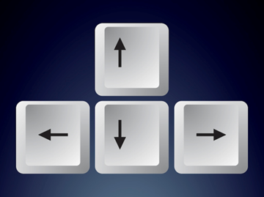
Merry Christmas – Level 3 (Part 3) - Laptops
  Elf Sprite - Code
  Elf Sprite
  Example
To code you must select the elf sprite in the bottom right corner
This code moves the elf using the direction buttons in the bottom right of your keyboard
Scratch is a project of the Scratch Foundation, in collaboration with the Lifelong Kindergarten Group at the MIT Media Lab. It is available for free at https://scratch.mit.edu

Slide 10
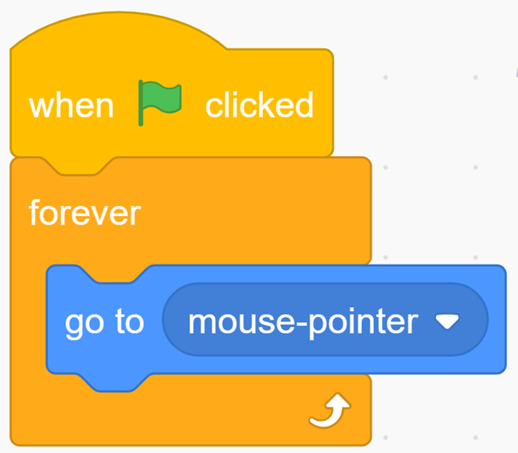
Merry Christmas – Level 3 (Part 3) - Tablet
  Elf Sprite - Code
  Elf Sprite
  Example
To code you must select the elf sprite in the bottom right corner
This code moves the elf to where you touch the screen.
Scratch is a project of the Scratch Foundation, in collaboration with the Lifelong Kindergarten Group at the MIT Media Lab. It is available for free at https://scratch.mit.edu

Slide 11
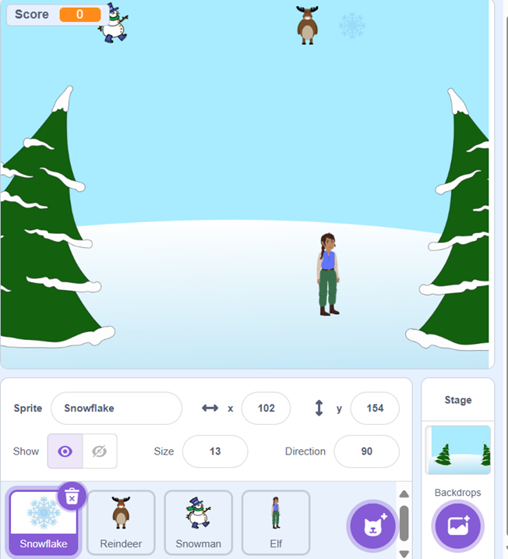
Merry Christmas – Level 3 (Part 4)
  Choose more Sprites
  The Reason for This
Choose more sprites in the bottom right where you got the elf sprite
These sprites will fall from the sky, to be caught!!
Scratch is a project of the Scratch Foundation, in collaboration with the Lifelong Kindergarten Group at the MIT Media Lab. It is available for free at https://scratch.mit.edu

Slide 12
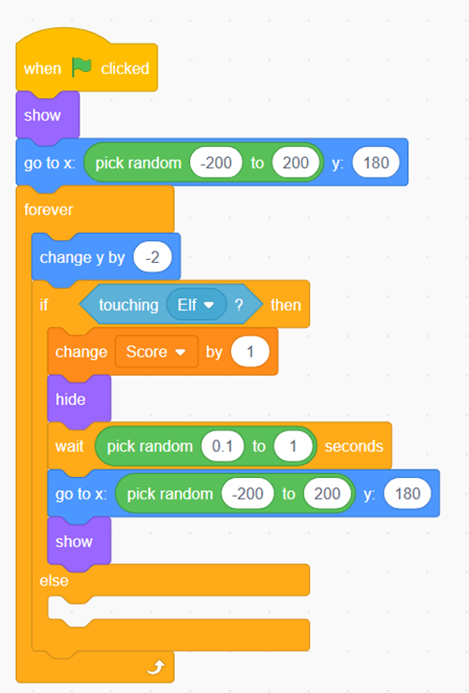
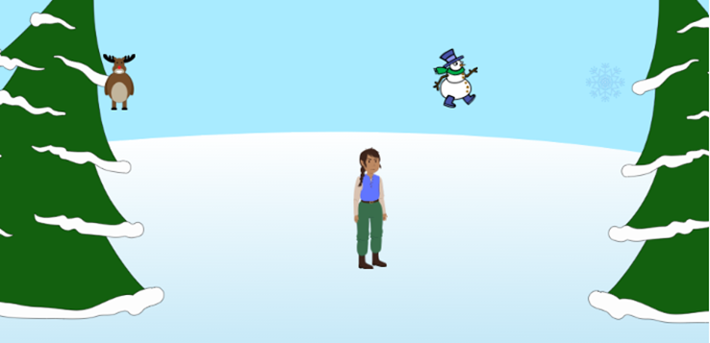
Merry Christmas – Level 3 (Part 5)
  Sprites - Code
This code makes the sprites fall down in random spots. Make sure you include the if-else function for level 3!!!
Starts the sprite at a random position
Moves the sprite down
if Sprite is touching Elf then
Increases the score by 1
Hide the sprite →
wait →
go to →
Show the sprite →
Resets the sprite to fall again after being caught.
← Next Page!
Scratch is a project of the Scratch Foundation, in collaboration with the Lifelong Kindergarten Group at the MIT Media Lab. It is available for free at https://scratch.mit.edu

Slide 13
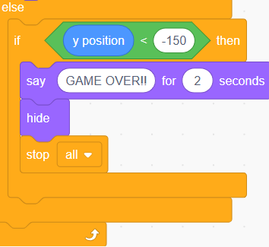
Merry Christmas – Level 3 (Part 6)
  Game Over - Code
The Broadcast Code
If ((y position) < -150)→then - Checks if the sprite has fallen below the bottom of the screen.
Say [GAME OVER!!] for 2 seconds –
Hide - Hides the sprite after showing the message.
Stop [all] - Stops all scripts in the entire project — ending the game.
This is the code added to the bottom of the else-if, that I mentioned in the last page!!
Scratch is a project of the Scratch Foundation, in collaboration with the Lifelong Kindergarten Group at the MIT Media Lab. It is available for free at https://scratch.mit.edu

Slide 14
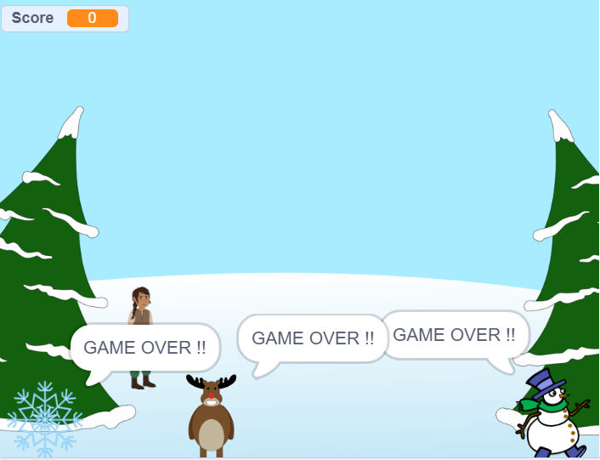
Merry Christmas – Level 3 (Finished!)
  Sprites Saying GAME OVER !
In this case when the three sprites (snowman, snowflake and reindeer) go past the elf (or the Y – axis of where the elf is situated: y = 150). The code will tell the sprites to say GAME OVER !!
Scratch is a project of the Scratch Foundation, in collaboration with the Lifelong Kindergarten Group at the MIT Media Lab. It is available for free at https://scratch.mit.edu

